Slide 1
Agenda
Linear Regression
Logistic Regression
Workshop – 1: linear regression (PyTorch)
Workshop – 2: Pandas
Workshop – 3: Logistic regression
Neural Network 1,2

Slide 2
Machine Learning – 1 Linear Regression
Tsemach Mizrachi
FMS

Slide 3
Model Representation
A dataset of pricing houses in Tal-Aviv
Supervised Learning
Given the “right answer” for each example in the data
Regression Problem
Predict real-valued output
Classification: discrete-value output

Slide 4
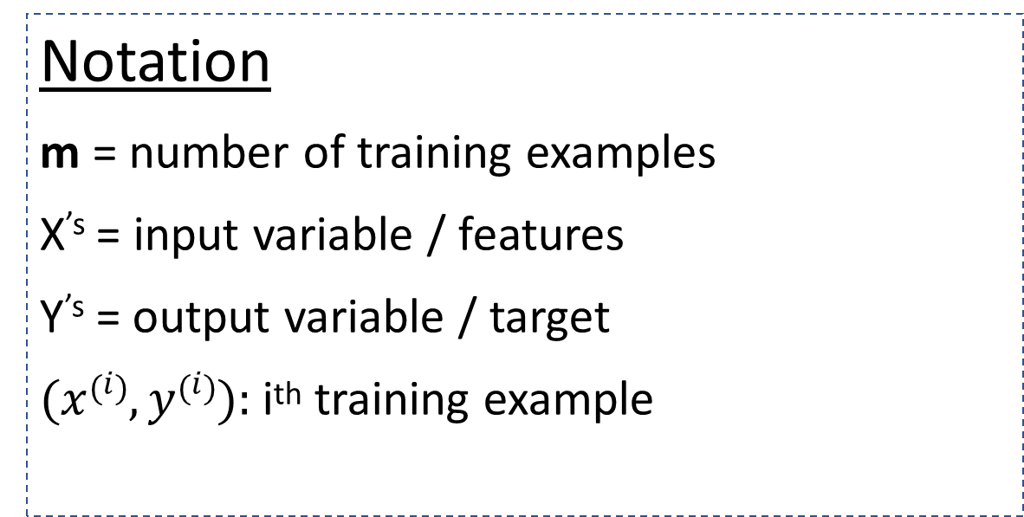
Model Representation
A dataset of pricing houses in Tal-Aviv
Size (M²) - X | Price (Mש"ח ) - Y
80 | 3.5
100 | 4.5
50 | 1.5
140 | 5.5
Notation
m = number of training examples
X^{’s} = input variable / features
Y^{’s} = output variable / target
$(x\left(i\right), y\left(i\right)):$i^{th} training example

Slide 5

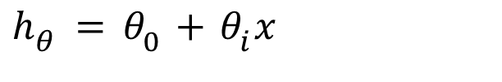
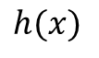
Model Representation
Training set
^{How do we represent h?}
$$h_{θ}=θ_{0}+θ_{i}x$$
Learning Algorithm
^{Shorthand:} $h\left(x\right)$
Size of House
(x)
Estimate
Price
(y)
$$h(x)$$
h
(hypothesis)
x
x
y
x
x
x
x
h maps from x’^{s} ➔ y’^{s}
x
x

Slide 6
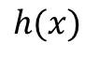
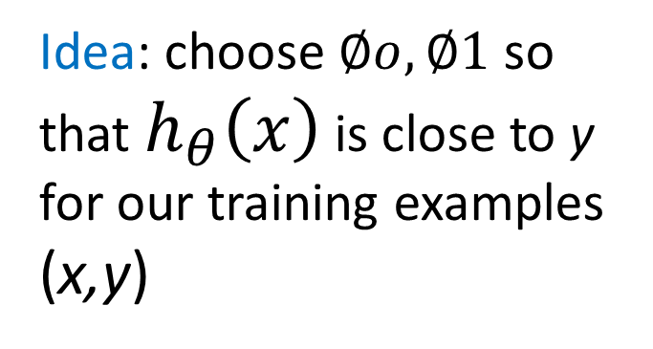

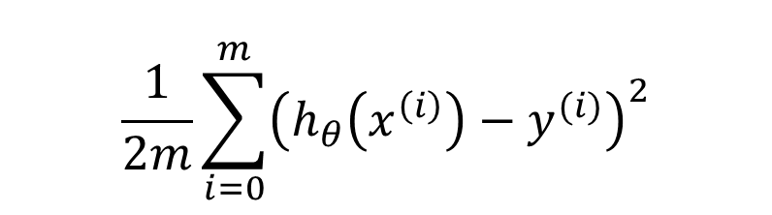
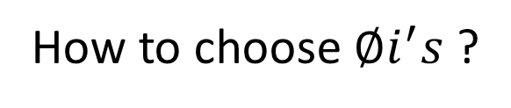
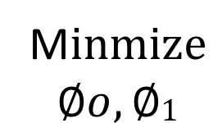
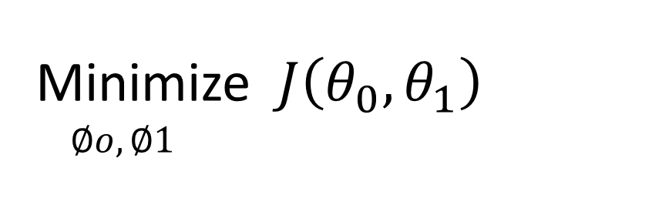
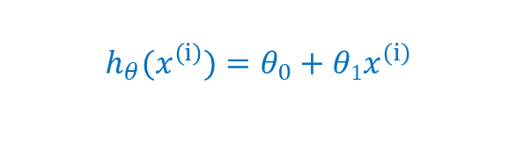
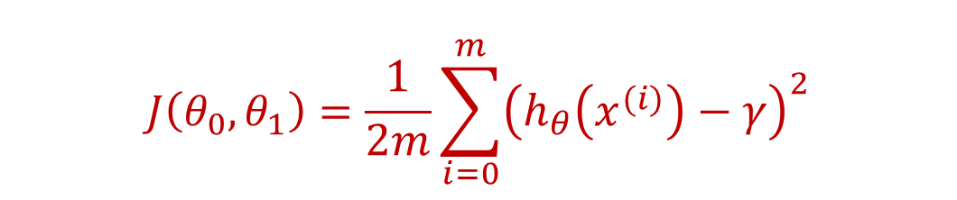
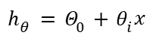
Cost Function
$$\frac{1}{2m}\sum_{i=0}^{m}{{\left(h_{θ}\left(x^{\left(i\right)}\right)−y^{(i)}\right)}^{2}}$$
$$h(x)$$
M$inmize$
$$∅o,∅1$$
x
x
y
x
x
x
$$h_{θ}=Θ_{0}+θ_{i}x$$
$$h_{θ}{(x}^{\left(ⅈ\right)})=θ_{0}+θ1x^{\left(ⅈ\right)}$$
x
x
x
$$J\left(θ_{0},θ_{1}\right)=\frac{1}{2m}\sum_{i=0}^{m}{{\left(h_{θ}\left(x^{\left(i\right)}\right)−γ\right)}^{2}}$$
How to choose $∅i^{′}s$ ?
Idea: choose $∅o,∅1$ so that $h_{θ}\left(x\right)$ is close to y for our training examples (x,y)
Minimize $J\left(θ_{0},θ_{1}\right)$
$∅o,∅1$
Cost Function

Slide 7
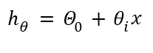
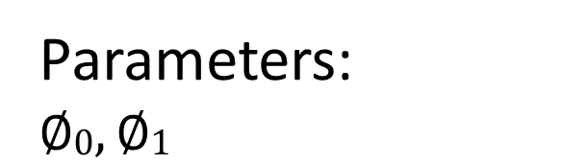
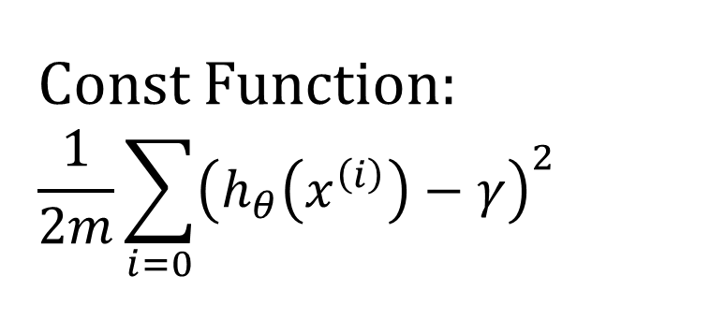
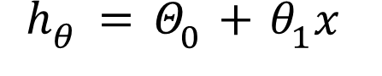
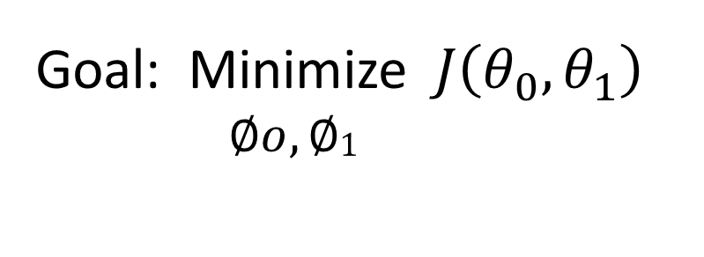
Cost Function – intuition - I
Const Function:
$$\frac{1}{2m}\sum_{i=0}{{\left(h_{θ}\left(x^{\left(i\right)}\right)−γ\right)}^{2}}$$
$$h(x)$$
x
x
y
x
x
x
$$h_{θ}=Θ_{0}+θ_{i}x$$
x
x
x
Goal: Minimize $J\left(θ_{0},θ_{1}\right)$
$∅o,∅1$
Hypothesis:
$$h_{θ}=Θ_{0}+θ_{1}x$$
Parameters:
$$∅0,∅1$$

Slide 8
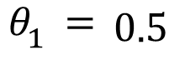
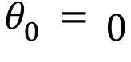
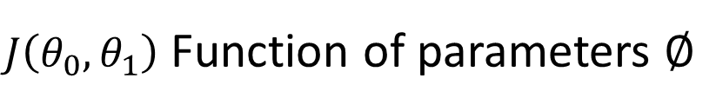
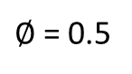
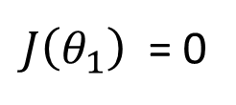
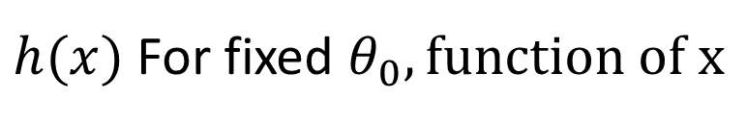
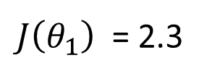
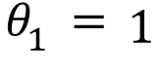
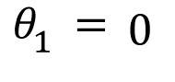
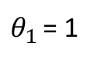
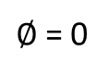
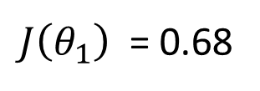
$h(x)$ For fixed $θ_{0}, function of x$
$J\left(θ_{0},θ_{1}\right)$ Function of parameters $∅$
$θ_{1 }$= 1
x
x
3
x
3
2
$∅$ = 0.5
x
x
x
2
$θ_{0}=0$
x
x
1
x
1
$∅$ = 0
x
x
x
1
2
3
1
2
3
$θ_{1}=1$
$J\left(θ_{1}\right)$ = 0
➔
$$θ_{1}=0.5$$
$J\left(θ_{1}\right)$ = 0.68
➔
$$θ_{1}=0$$
➔
$J\left(θ_{1}\right)$ = 2.3

Slide 9
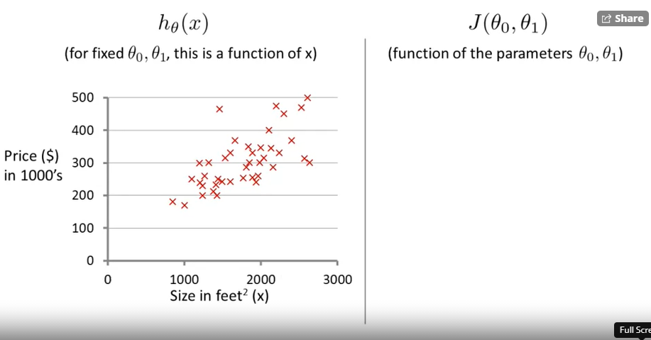
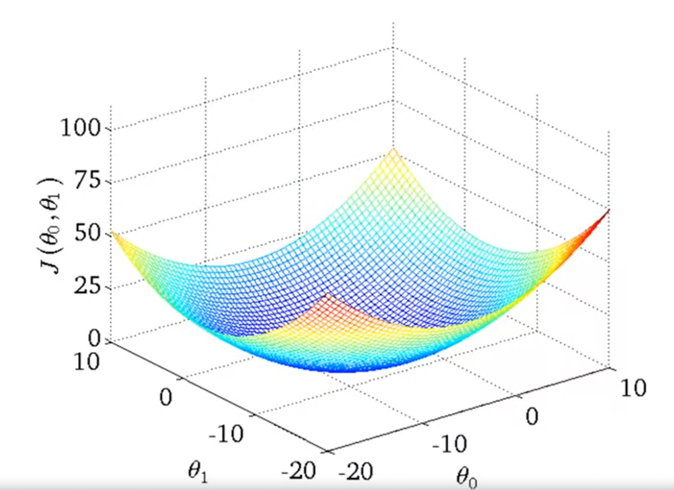
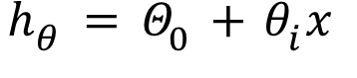
Cost Function – intuition - II
$$h_{θ}=Θ_{0}+θ_{i}x$$
Price
(y)

Slide 10
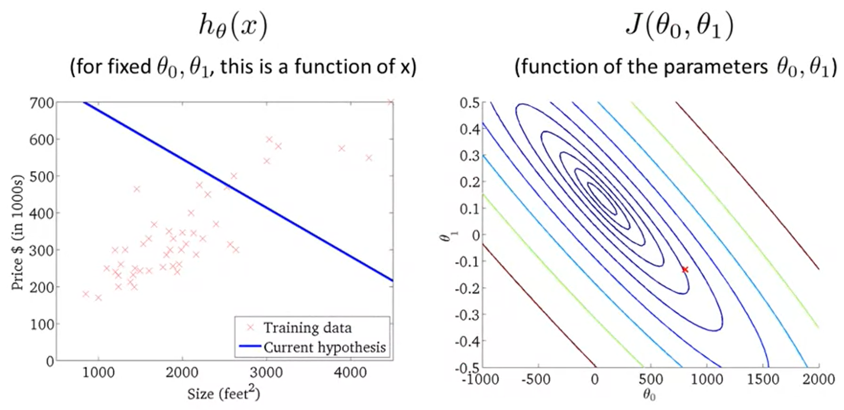
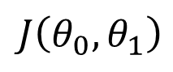

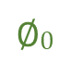

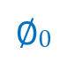
Cost Function – intuition - II
$$J\left(θ_{0},θ_{1}\right)$$
x
x
x
x
$$∅1$$
x
$$∅1$$
$$∅0$$
$$∅0$$

Slide 11
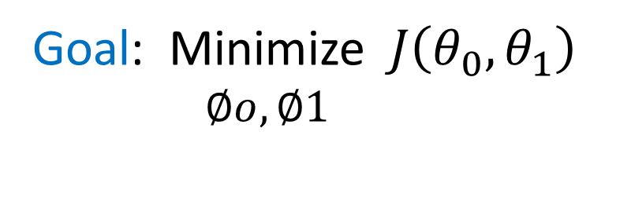
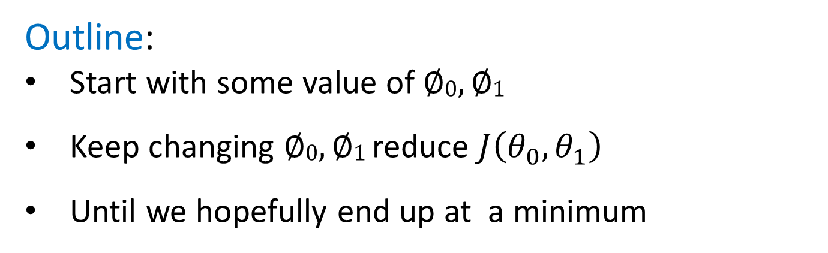

Parameters Learning – Gradient Descent
Given: some function $J\left(θ_{0},θ_{1}\right)$
Goal: Minimize $J\left(θ_{0},θ_{1}\right)$
$∅o,∅1$
Outline:
Start with some value of $∅0,∅1$
Keep changing $∅0,∅1$ reduce $J\left(θ_{0},θ_{1}\right)$
Until we hopefully end up at a minimum

Slide 12
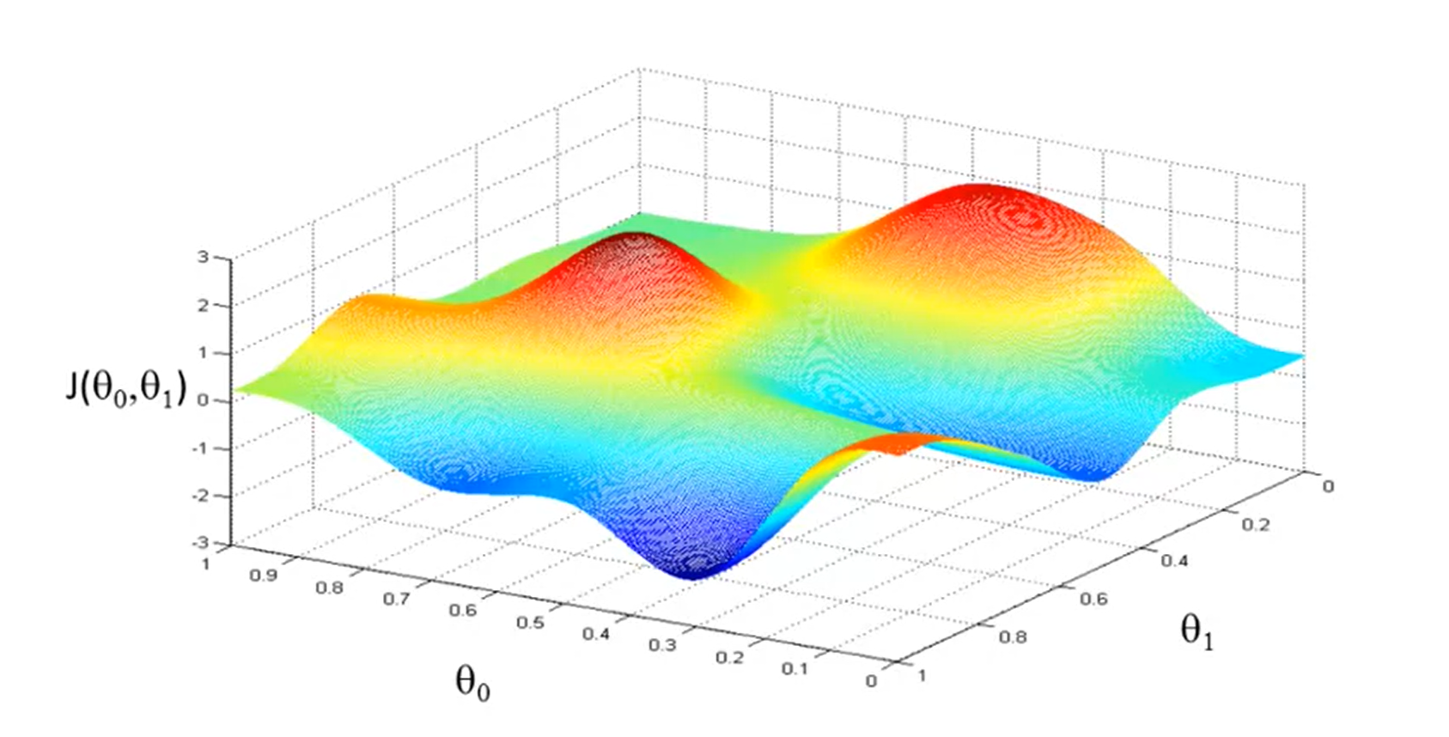
Parameters Learning – Gradient Descent
x
x
x
x
x
x
x
x
x

Slide 13
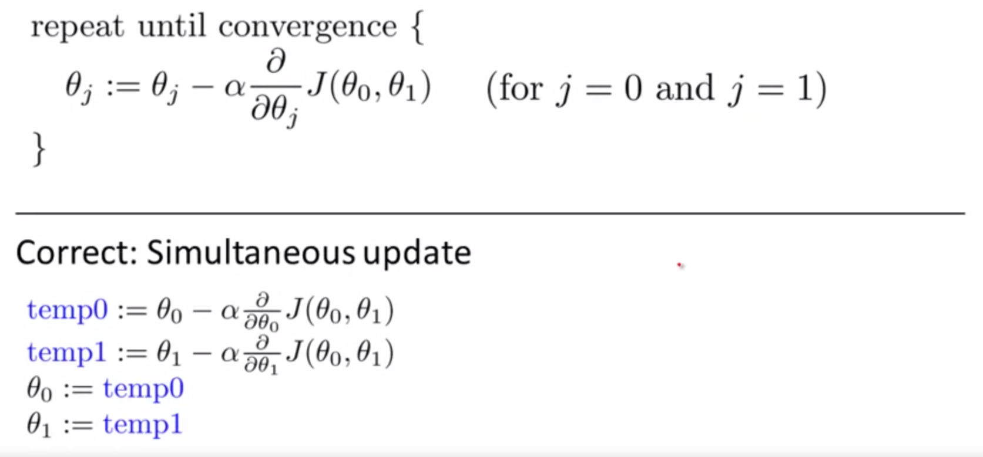
Gradient Descent Algorithm
Learning rate
Note: the update are simultaneous

Slide 14
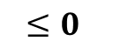
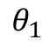
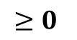
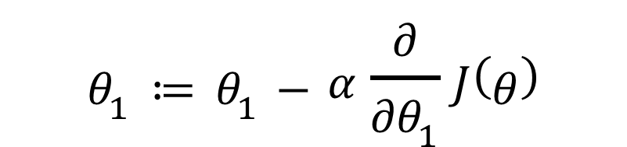
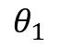
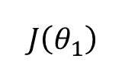
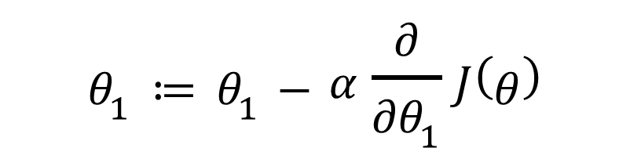
Gradient Descent Algorithm – Intuition
$$J\left(θ_{1}\right)$$
$$θ_{1}≔θ_{1}−α\frac{∂}{∂θ_{1}}J\left(θ\right)$$
x
x
$$≥0$$
$$θ_{1}$$
$$θ_{1}≔θ_{1}−α\frac{∂}{∂θ_{1}}J\left(θ\right)$$
x
$$≤0$$
$$θ_{1}$$

Slide 15
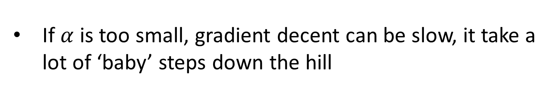
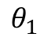
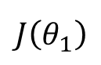

Gradient Descent Algorithm – Choosing $α$
If $α$ is too small, gradient decent can be slow, it take a lot of ‘baby’ steps down the hill
If $α$ is too large, gradient decent can overshoot the minimum. It may fail to converge, or even diverge
x
$$J\left(θ_{1}\right)$$
x
x
x
x
$$θ_{1}$$

Slide 16

Gradient Descent for Linear Regression

Slide 17



Gradient Descent for Linear Regression
$\frac{∂}{∂θj}J\left(θ0,θ1\right)=\frac{∂}{∂θj}∙\frac{1}{2m}\sum_{i=0}^{m}{\left(h∅\left(x\left(i\right)\right)−y\right)2}$
$= \frac{∂}{∂θj}∙\frac{1}{2m}\sum_{i=0}^{m}{\left(θ0+θ1x\left(i\right)−y\right)2 }$
$$J=0:\frac{∂}{∂θ0}J\left(θ0,θ1\right)=\frac{1}{M}∙\sum_{i=0}^{m}{\left(h∅\left(x\left(i\right)\right)−y\right)}$$
$$J=1:\frac{∂}{∂θ1}J\left(θ0,θ1\right)=\frac{1}{M}∙\sum_{i=0}^{m}{\left(h∅\left(x\left(i\right)\right)−y\right)}∙x^{(i)}$$
$$J=0:\frac{∂}{∂θ0}J\left(θ0,θ1\right)=\frac{1}{M}∙\sum_{i=0}^{m}{\left(h∅\left(x\left(i\right)\right)−y\right)}$$
$$J=1:\frac{∂}{∂θ1}J\left(θ0,θ1\right)=\frac{1}{M}∙\sum_{i=0}^{m}{\left(h∅\left(x\left(i\right)\right)−y\right)}∙x^{(i)}$$
Calculate ($θ_{0}, θ_{1})$

Slide 18

Gradient Descent Algorithm For Linear Regression

Slide 19



Feature Scaling
Let $h\left(x\right): θ_{0}∙X_{0}+θ_{1}∙X_{1}…θ_{n}∙X_{n} While: X_{0}=1$
$$X_{1}:size of house in M2 =(0−500)$$
$$X_{2}:number of badrooms (1 −7)$$
Because of the deferential scaling of $θ_{1}$ and $θ_{2}$ gradient decent has hard time finding its way to local minimum
It will require a lot of iterations to converge
$$θ_{2}$$
$$θ_{1}$$

Slide 20
Feature Scaling
$$X_{1}=\frac{Size of house}{500} 0≤ X_{1}≤1$$
$$X_{2}=\frac{number of basrooms}{7} 0≤ X_{2}≤1$$
Now gradient decent able to find it way to local minimum fast faster
$$θ_{2}$$
$$θ_{1}$$

Slide 21




Feature Scaling – Mean Normalization
Make features approximately around zero mean $−1≤ X_{i}≤1$
$$X_{1}=\frac{size−100}{500}$$
$$X_{2}=\frac{\#rooms−2}{7}$$
Option – 1:
normalize with range
$μ$ – mean of $X$
Option – 2:
normalize with standard deviation
$μ$ – mean of $X$
$$X_{i}=\frac{X_{i} − μ}{STD} −1≤ X_{i}≤1$$
$$X_{i}=\frac{X_{i} − μ}{S_{1}} −1≤ X_{i}≤1$$
Where $S_{1}= X_{max} − X_{min}$

Slide 22


Gradient Decent Converge Test
How do we know GC is converging?
Plotting $J\left(θ_{1}\right) function of \#iterations$
Min $J\left(∅ \right)$
$∅$
Converge area
No of iteration

Slide 23
Thank Yo
u

Slide 24
Machine Learning – 2 Logistic Regression
Tsemach Mizrachi

Slide 25



Classification
Logistic regression is known as ‘classification’
$$y ∈\left\{0, 1\right\}$$
0: “Negative class” (like not spam, not fraud ..)
1: “Negative class” (like spam, fraud..)
Multi variable classification note as:
$$y ∈\left\{0, 1, 2, 3, 4, …\right\}$$
_{Each number symbol a category}
_{Vector representation of} $H_{θ}\left(x\right):$
$$θ= \left[\begin{matrix}θ_{0} \\ θ_{1} \\ ⋮ \\ θ_{n}\end{matrix}\right] X=\left[\begin{matrix}x_{0} \\ x_{1} \\ ⋮ \\ x_{n}\end{matrix}\right]⇒h_{θ}\left(x\right)= θ_{0}∙x_{0}∙θ_{1}∙x_{1}…θ_{n}∙x_{n}=θ^{T}∙X$$

Slide 26





Classification
$$h_{θ}\left(x\right)$$
$$h_{θ}\left(x\right)$$
x
x
x
U$sing linear regression$
$is bad idea$
Threshold classification output $h_{θ}\left(x\right) at 0.5:$
_{if} $h_{θ}\left(x\right)≥0.5 then predict{}_{}^{′}y=1“$
_{if} $h_{θ}\left(x\right)<0.5 then predict{}_{}^{′}y=0"$

Slide 27






Hypothesis Representation
We want $0 ≤h_{θ}\left(x\right)≤1$
$$h_{θ}\left(x\right)=θ^{T}∙X$$
$$h_{θ}\left(x\right)={g(θ}^{T}∙X)$$
_{if} $h_{θ}\left(x\right)<0.5 then predict{}_{}^{′}y=0"$
$$z\left(z\right)=\frac{1}{1+ e^{{−θ}^{T}z}}$$
_{where}
$$G\left(z\right)=\frac{1}{1+ e^{−z}}$$
z
$$Sigmoid function$$
or
$$Logistic function$$
$$h_{θ}\left(x\right)=\frac{1}{1+ e^{{−θ}^{T}∙X}}$$

Slide 28

Hypothesis Interpretation
$h_{θ}\left(x\right)=$ estimate probability that y = 1 for given input x
$For example:$if $h_{θ}\left(x\right)=0.7⇒there is a 70\% of malignent tumer (y=1)$
So we can define $h_{θ}\left(x\right)$as probability function
$h_{θ}\left(x\right)=P\left(y=1 \right|x, θ)$ the probability that y = 1 given x parametrize by $θ$
$P\left(y=0 \right|x, θ)$ + $P\left(y=1 \right|x, θ)=1$
$$P\left(y=0 \right|x, θ)=1−P\left(y=1 \right|x, θ)$$

Slide 29








Decision Boundary
y
$$g\left(z\right)$$
$$h_{θ}\left(x\right)={g(θ}^{T}∙X)$$
$$G\left(z\right)=\frac{1}{1+ e^{−z}}$$
$$Predict y=1 ifh_{θ}\left(x\right) ≥0.5$$
$$Predict y=0 ifh_{θ}\left(x\right) <0.5$$
z
$$z<0⇒g\left(z\right)<0.5⇒y=0$$
$$z≥0⇒g\left(z\right)≥0.5⇒y=1$$
$$y=1 if z≥0⇒ θ^{T}∙X>0$$
$$y=0 if z<0⇒ θ^{T}∙X<0$$

Slide 30







Decision Boundary – example I
$$θ=\left|\begin{matrix}−3 \\ 1 \\ 1\end{matrix}\right|⇒$$
$$h_{θ}\left(x\right)=g(−3+ 1∙ X_{1}+1∙X_{2})$$
$$y=1$$
$$y=0$$
$$predict y=1 if θ^{T}∙X≥0⇒−3+ 1∙ X_{1}+1∙X_{2}≥0$$
$$⇒{predict y=1 if X}_{1}+X_{2}≥3$$
$${ X}_{1}+X_{2}=3⇒Decision Boundary$$
$$⇒{predict y=0 if X}_{1}+X_{2}<3$$

Slide 31





Non-Linear decision boundary – example II
$$θ=\left|\begin{matrix}−1 \\ 0 \\ 0 \\ 1 \\ 1\end{matrix}\right|⇒$$
$$h_{θ}\left(x\right)=g(θ_{0}+θ_{1}∙X_{1}+θ_{2}∙ X_{2}+θ_{3}∙X_{1}^{2}+θ_{4}∙X_{4}^{2})$$
$$high order polinom may create$$
$$a much much more$$
$$decision boundary coplext shape$$
$$predict y=1 if −1+X_{1}^{2}+X_{2}^{2}≥0$$
$$⇒X_{1}^{2}+X_{2}^{2}≥1$$
$$⇒X_{1}^{2}+X_{2}^{2}=1⇒Decision Boundary$$

Slide 32





Logistic regression – Cost function
$$Traing set: \left\{\left(x^{1}, y^{1}\right),x^{2}, y^{2}),⋯,(x^{m}, y^{m})\right\}$$
$$X∈\left|\begin{matrix}X_{0} \\ X_{1} \\ {\begin{aligned}⋮ \\ X\end{aligned}}_{n}\end{matrix}\right|$$
$$m examples$$
$$x_{0}=1, y∈\{0, 1\}$$
$$h_{θ}\left(x\right)=\frac{1}{1+ e^{{−θ}^{T}∙X}}$$
$$How we choose paramters θ?$$

Slide 33








Logistic regression – Cost function
$$linear regression we defined:J\left(θ\right)=\frac{1}{m}\sum_{i=0}^{m}{\frac{1}{2}\left(h∅\left(x\left(i\right)\right)−y\right)2}$$
$$Cost\left(h∅\left(x\right),y\right)={\frac{1}{2}\left(h∅\left(x\right)−y\right)}^{2}$$
$$h_{θ}\left(x\right)=\frac{1}{1+ e^{{−θ}^{T}∙X}}$$
$$non convex$$
$$need a$$
$$cost function that is$$
$$convex$$
$$J(θ)$$
$$J(θ)$$
$$θ$$
$$θ$$

Slide 34















Logistic regression – Cost function
$$Cost\left(h∅\left(x\right),y\right)=\left\{\begin{aligned} if y=1⇒−\log\left(h_{θ}\left(x\right)\right) \\ if y=0⇒−\log\left({1−h}_{θ}\left(x\right)\right) \end{aligned}while 0≤h_{θ}\left(x\right)≤1\right.$$
$$log⁡(z)$$
$$h_{θ}\left(x\right)⇒1 and y=1,−log\left(h_{θ}\left(x\right)\right)⇒0, Cost⇒0$$
$$log(z)$$
$$h_{θ}\left(x\right)⇒1 and y=0,−log\left({1−h}_{θ}\left(x\right)\right)⇒∞, Cost⇒∞$$
$$1$$
$$z$$
$$0$$
$$−log⁡(z)$$
$$if y=1$$
$$if y=0$$
$$J(θ)$$
$$J(θ)$$
$$h_{θ}$$
$$h_{θ}$$
$$0$$
$$1$$
$$0$$
$$1$$

Slide 35



Simplified Cost function
$$J\left(θ\right)=\frac{1}{m}\sum_{i=0}^{m}{Cost\left(h∅\left(x\left(i\right)\right),y\right)}$$
$$Cost\left(h∅\left(x\right),y\right)=\left\{\begin{aligned} if y=1⇒−\log\left(h_{θ}\left(x\right)\right) \\ if y=0⇒−\log\left({1−h}_{θ}\left(x\right)\right) \end{aligned}\right.$$
$$y∈\{0, 1\}$$
$Cost\left(h∅\left(x\right),y\right)=−y∙\log\left(h_{θ}\left(x\right)\right)−\left(1−y\right)∙log⁡(1−h_{θ}\left(x\right)$)
$$if y=1⇒cost\left(h∅\left(x\right),y\right)=−1∙\log\left(h_{θ}\left(x\right)\right)−0∙log⁡(1−h_{θ}\left(x)\right)=−log\left(h_{θ}\left(x\right)\right)$$
$$if y=0⇒cost\left(h∅\left(x\right),y\right)=−0∙\log\left(h_{θ}\left(x\right)\right)−\left(1−y\right)∙log⁡(1−h_{θ}\left(x)\right)=−log\left(1−h_{θ}\left(x\right)\right)$$

Slide 36





Logistic Regression – fit parameters
_{if} $h_{θ}\left(x\right)<0.5 then predict{}_{}^{′}y=0"$
$$To fit the paramters θ with cost function J(θ):$$
$$Min J\left(θ\right)$$
$$θ$$
$$Repeat \{$$
$$θ_{j }≔θ_{j }−α\sum_{i=0}^{m}{(h_{θ}\left(x^{i}\right)− y^{i})∙X_{j}^{(i)}}$$
$$\}$$
_{Simultaneously update all} $θ_{j }$

Slide 37









Logistic Regression – Multiclass classification
_{if} $h_{θ}\left(x\right)<0.5 then predict{}_{}^{′}y=0"$
$suppose$ we have a training set like:
Class A:
Class B:
Class B:
$h_{θ}^{(1)}{(x)}_{ }$
$h_{θ}^{(2)}{(x)}_{ }$
_{One – vs - all}
$$Max h_{θ}^{(i)}{(x)}_{ }$$
$i$
$h_{θ}^{(3)}{(x)}_{ }$

Slide 38
Thank Yo
u

Slide 39
Workshop – 1 Tensors Introduction
Tsemach Mizrachi

Slide 40
PyTorch Tensor Operations
Tensors are the building block of all PyTorch operations
At its core, PyTorch is a library for processing tensors
A tensor is a number, vector, matrix, or any n-dimensional array
Important: all elements of a tensors require same data type.

Slide 41
Creating a Tensor

Slide 42
Tensor Data Types
Tensor can be scalar, vector, matrix or multi dimension matrix
a = torch.tensor(4.)
print(a.shape) # note: a is a scalar, there is no dimension to scalars.
a.dtype
Result
torch.Size([])
torch.float32
Tensor can be scalar, vector, matrix or multi dimension matrix
v = torch.tensor([4., 5, 6, 7]) # all tensors' items need to be the same data type
v
Result
torch.float32
tensor([4., 5., 6., 7.])

Slide 43
Tensor Data Type
v = torch.FloatTensor([1, 2, 3, 4, 5, 6]) # create a float tensor
print(v.dtype)
Result
torch.float32
v = torch.tensor([1, 2, 3, 4, 5, 6]) # create a int64 tensor
print(v.size())
Result
torch.Size([6])

Slide 44
Tensor Rearrange
v = torch.FloatTensor([1, 2, 3, 4, 5, 6]) # create a float tensor
print(v.view(3, 2)) # rearange to a (3, 2) matrix
Result
tensor([[1., 2.],
[3., 4.],
[5., 6.]])
v = torch.FloatTensor([1, 2, 3, 4, 5, 6]) # create a float tensor
print(v.view(3, -1)) # -1 => infer the number of columns, rearrange to a (3, 2)
Result
tensor([[1., 2.],
[3., 4.],
[5., 6.]])

Slide 45
Tensor Operations
A 2D Tensor matrix
m = torch.tensor([[5., 6],
[7, 8],
[9, 10]])
print(m.shape)
m
Result
torch.Size([3, 2]) ← the shape is in the form of [rows, columns]
tensor([[ 5., 6.], [ 7., 8.], [ 9., 10.]])

Slide 46
Tensor Slicing

Slide 47
Tensor Slicing
v = torch.tensor([1, 2, 3, 4, 5, 6])
print(v[2:5]) # slice: print items in indexes 2,3,4
Result
tensor([3, 4, 5])
v = torch.tensor([1, 2, 3, 4, 5, 6, 7])
print(v[2:]) # slice: print from index 2 until the end
Result
tensor([3, 4, 5, 6, 7])

Slide 48
Tensor Slicing
x = torch.arange(18).view(3, 3, 2) # create a 3D matrix
x
tensor([[[ 0, 1, 2],
[ 3, 4, 5]],
[[ 6, 7, 8],
[ 9, 10, 11]],
[[12, 13, 14],
[15, 16, 17]]])
Matrix 1
Matrix 2
Matrix 3
print(x[1, 0:1, 1:2]) # slice from matrix 1, row 0:1, column 1:2 (excluded)
tensor([[[ 0, 1, 2],
[ 3, 4, 5]],
print(x[1, :, :]) # slice from matrix 1, all rows, all columns

Slide 49
Tensor Operations and Gradients

Slide 50
Tensor Operations
A 3D Tensor matrix
d3 = torch.tensor([
[[111, 112, 113],
[121, 122, 123]],
[[211, 212, 213],
[221, 222, 223.]]])
print(d3.shape)
print(d3)
Result
torch.Size([2, 2, 3])
tensor([
[ [111., 112., 113.],
[121., 122., 123.]],
[ [211., 212., 213.],
[221., 222., 223.]
]
])

Slide 51
Tensor Operations and gradients
Linear equation
x = torch.tensor(3.)
w = torch.tensor(4., requires_grad=True)
b = torch.tensor(5., requires_grad=True)
x, w, b
Result
We've created three tensors: `x`, `w`, and `b`, all numbers. `w` and `b` have an additional parameter `requires_grad` set to `True`
Create linear equation
# arithmetic operations
y = w * x + b
y
Result
tensor(17., grad_fn=<AddBackward0>)

Slide 52
Tensor Operations and gradients
As expected, `y` is a tensor with the value `3 * 4 + 5 = 17`. What makes PyTorch unique is that we can automatically compute the derivative of `y` w.r.t. the tensors that have `requires_grad` set to `True` i.e. w and b. This feature of PyTorch is called _autograd_ (automatic gradients).
To compute the derivatives, we can invoke the `.backward` method on our result `y`.
Compute the derivatives
# arithmetic operations
y = w * x + b
y
The derivatives of `y` with respect to the input tensors are stored in the `<tensor>.grad` property of the respective tensors.

Slide 53
Tensor Operations and gradients
# display gradients, x = 3, w = 4, b = 5
y.backward()
print('dy/dx:', x.grad) # we didn't defined x with gradiant
print('dy/dw:', w.grad) # the gradient of y with respect of w => 1 * 3 + 0 = 3
print('dy/db:', b.grad) # the gradient of y with respect of b => 0 * 0 + 1 = 1 (we trait b as the variable of the derivative)
Result
dy/dx: None
dy/dw: tensor(3.)
dy/db: tensor(1.)
As expected, `dy/dw` has the same value as `x`, i.e., `3`, and `dy/db` has the value `1`. Note that `x.grad` is `None` because `x` doesn't have `requires_grad` set to `True`.
The "grad" in `w.grad` is short for _gradient_, which is another term for derivative. The term _gradient_ is primarily used while dealing with vectors and matrices.

Slide 54
Tensor Functions
Apart from arithmetic operations, the `torch` module also contains many functions for creating and manipulating tensors. Let's look at some examples.

Slide 55
Tensor Functions
t6 = torch.full((3, 2), 42) # create a tensor with a fixed value for every element
t6
Result
tensor([[42, 42],
[42, 42],
[42, 42]])
t7 = torch.cat((t3, t6)) # concatenate two tensors with compatible shapes
t7
Result
tensor([[ 5., 6.],
[ 7., 8.],
[ 9., 10.],
[42., 42.],
[42., 42.],
[42., 42.]])

Slide 56
Tensor Functions
t8 = torch.sin(t7) # compute the sin of each element
t8
Result
tensor([[0.9589, 0.2794],
[...],
[-0.34167, 0.7632]])
t9 = t8.reshape(3, 2, 2) # change the shape of a tensor
t9
Result
tensor([[[-0.9589, -0.2794],
[ 0.6570, 0.9894]],
[[ 0.4121, -0.5440],
[-0.9165, -0.9165]],
[[-0.9165, -0.9165],
[-0.9165, -0.9165]]])

Slide 57
Interoperability with Numpy
Numpy is a popular open-source library used for mathematical and scientific computing in Python. It enables efficient operations on large multi-dimensional arrays and has a vast ecosystem of supporting libraries, including:

Slide 58
Interoperability with Numpy
import numpy as np
x = np.array([[1, 2], [3, 4.]]) # create numpy array
y = torch.from_numpy(x) # convert the numpy array to a torch tensor.
y
Result
tensor([[1., 2.],
[3., 4.]], dtype=torch.float64)
# let's verify that the numpy array and torch tensor have similar data types.
x.dtype, y.dtype
Result
(dtype('float64'), torch.float64)

Slide 59
Interoperability with Numpy
z = y.numpy() # convert a torch tensor to a numpy array
z
Result
array([[1., 2.], [3., 4.]])

Slide 60
Interoperability with Numpy
The interoperability between PyTorch and Numpy is essential because most datasets you'll work with will likely be read and preprocessed as Numpy arrays.
You might wonder why we need a library like PyTorch at all since Numpy already provides data structures and utilities for working with multi-dimensional numeric data.
There are two main reasons:
Autograd: The ability to automatically compute gradients for tensor operations is essential for training deep learning models.
GPU support: While working with massive datasets and large models, PyTorch tensor operations can be performed efficiently using a Graphics Processing Unit (GPU). Computations that might typically take hours can be completed within minutes using GPUs.

Slide 61
Vector and Matrix Manipulation

Slide 62
Vector Manipulations
v1 = torch.tensor([1, 2, 3]) # create a vector of [1, 2, 3]
v2 = torch.tensor([1, 2, 3]) # create a vector of [1, 2, 3]
v1 * v2 # element wise multiplication => tensor([1, 4, 9])
v1 * 5 # multiply by scalar => tensor([ 5, 10, 15])
torch.dot(v1, v2) # dot product, v1[0] * v2[0] + v1[1] * v2[1] ... + v1[n] * v2[n] => 14
torch.linspace(0, 10, 5) # dived the space of 0:10 to 5 pieces.
Result
tensor([ 0.0000, 2.5000, 5.0000, 7.5000, 10.0000])

Slide 63
Matrix Multiplication
a = torch.tensor([0, 3, 5, 5, 5, 2]).view(2, 3) # create a matrix of dim(2,3)
b = torch.tensor([3, 4, 3, -2, 4, -2]).view(3, 2) # create a matrix of dim(3, 2)
print(a @ b) # multiply a and b
print(torch.matmul(a, b)) # multiply a and b
Result
tensor([[ 29, -16],
[ 38, 6]])
tensor([[ 29, -16],
[ 38, 6]])

Slide 64

Vector Manipulations
x = torch.linspace(0, 10, 100) # dive the spcae of 0:10 to 100 piceses
y = torch.exp(x) # y = exponent of x
import matplotlib.pyplot as plt
plt.plot(x.numpy(), y.numpy())

Slide 65
Exercises

Slide 66
Matrix Multiplication
Create a 3D matrix of dimension (3, 3, 2)
Print the whole matrix
Print the max number
Slice the second row of the second matrix
2. Create a vector between 0 to 10 with 100 elements
Create exponent from this vector
Create second exponent which is in reverse order of the vector
Draw a plot of the two vector on the same graph
Hint: use the plt.plot one after the other to plot second graph on the same ploy

Slide 67
Solution
Exercise - 1
torch.arange(18)
ms = torch.arange(18).view(3, 3, 2)
print(ms)
print('max:', torch.max(ms))
print(ms[1, 1:2, 0:2])
Result
tensor([[[ 0, 1], [[ 6, 7], [[12, 13],
[ 2, 3], [ 8, 9], [14, 15],
[ 4, 5]], [10, 11]], [16, 17]]])
max: tensor(17)
tensor([[8, 9]])

Slide 68

Solution
Exercise - 2
torch.arange(18)
ms = torch.arange(18).view(3, 3, 2)
print(ms)
print('max:', torch.max(ms))
print(ms[1, 1:2, 0:2])

Slide 69
Thank Yo
u

Slide 70
Linear Regression

Slide 71
Linear Regression
Create a linear pattern (a training set)
Declare a linear model with random parameters
Make use of gradient decent to fit the parameters
Make a prediction
We will look at two examples

Slide 72
Example-1: set the model ourselves
Import the needed packages
import torch
import numpy as np
import matplotlib.pyplot as plt
from torch.autograd import Variable

Slide 73
Example-1: set the model ourselves
We will use `w` and `b` as the parameter of the linear line as `y = w * x + b`
Create the training set
torch.manual_seed(2)
# create dummy data for training
x_train = torch.randn(100, 1) * 10
y_train = x_train + 3 * torch.randn(100, 1)
x_train = x_train.numpy()
y_train = y_train.numpy()
inputs = Variable(torch.from_numpy(x_train))
labels = Variable(torch.from_numpy(y_train))

Slide 74

Example-1: Use Standard Linear Class
Plot the training set
plt.plot(x_train, y_train, 'o') # plot the new X,Y
plt.xlabel('X')
plt.ylabel('Y')
Output

Slide 75
Example-1: Use Standard Linear Class
Define the LR inherit from nn.Module
class LR(torch.nn.Module):
def __init__(self, input_size, output_size):
super().__init__()
self.linear = torch.nn.Linear(input_size, output_size)
def forward(self, x):
return self.linear(x)
def get_parameters(self):
(w, b) = self.parameters()
return (w[0][0].item(), b[0].item())

Slide 76
Example-1: Use Standard Linear Class
Create instance of LR model
input_dim = 1 # takes variable 'x'
output_dim = 1 # takes variable 'y'
learning_rate = 0.01
epochs = 100
model = LR(input_dim, output_dim)
Note
Model is now an instance of LR we will work with

Slide 77
Example-1: Use Standard Linear Class
Plotting the initial regression line
def plot_fit(model: LR, title: str):
plt.title(title)
w, b = model.get_parameters()
print(w, b)
x1 = np.array([-30, 30])
y1 = w * x1 + b
plt.plot(x1, y1, 'r')
plt.scatter(x_train, y_train)
plt.xlabel('X')
plt.ylabel('Y')
plt.show()

Slide 78

Example-1: Use Standard Linear Class
Plotting the initial regression line
plot_fit(model, 'Initial Model')

Slide 79
Example-1: Use Standard Linear Class
Declare lost function and SGD optimizer
criterion = torch.nn.MSELoss()
optimizer = torch.optim.SGD(model.parameters(), lr=learning_rate)
Note:
Criterion: is a lost function that calculate the mean square error
Optimizer: calculate the derivative (gradian) using Stochastic Gradient Descent

Slide 80
Example-1: Use Standard Linear Class
Declare lost function and SGD optimizer
losses = []
for epoch in range(epochs):
optimizer.zero_grad() # clear gradient buffers
outputs = model(inputs) # make a prediction, given the inputs
loss = criterion(outputs, labels) # get loss for the predicted output
losses.append(loss.item()) # add the lost for plotting
loss.backward() # get gradients w.r.t to parameters
optimizer.step() # update parameters
print('epoch {}, loss {}'.format(epoch, loss.item()))

Slide 81

Example-1: Use Custom Module
Plot the losses (J Function)
plt.plot(range(epochs), losses)
plt.ylabel('Loss')
plt.xlabel('epoch')

Slide 82

Example-1: Use Custom Module
Plotting the model fitting
with torch.no_grad(): # we don't need gradients in the testing phase
if torch.cuda.is_available():
predicted = model(Variable(torch.from_numpy(x_train).cuda())).cpu().data.numpy()
else:
predicted = model(Variable(torch.from_numpy(x_train))).data.numpy()
plt.plot(x_train, y_train, 'go', label='True data', alpha=0.5)
plt.plot(x_train, predicted, '--', label='Predictions', alpha=0.5)
plt.legend(loc='best')
plt.show()

Slide 83
Thank Yo
u

Slide 84
Machine Learning – 3 Overfitting Regularization
Tsemach Mizrachi

Slide 85




Underfit / Overfit
“Underfit” or “high bias”
“good fit”
“overfitting” or “high variance”
Overfitting: too many features may cause the learned hypothesis to fit very well to the training set, meaning $J\left(θ\right)≈0$ but fail generalize on new examples.
Overfitting may cause if we have too many feature with too little data.
Generalization: the ability of the learned hypothesis to predict well on new examples.

Slide 86

Underfit / Overfit
“Underfit” or “high bias”
“good fit”
“overfitting” or “high variance”
Overfitting: large number of features and high degree polynom
may cause overfitting to new data.

Slide 87

Addressing Overfitting
Options:
Reduce number of features:
Manually reduce the features
Model selection algorithm (automatic feature selection
Regularization:
Keep all features but reduce the magnitude of paraments $θ_{j}$
Work well when we have a lot of features, each of which contributes a bit to predicting y.

Slide 88



Intuition of Regularization
Suppose we penalize $∅_{3}$ and $∅_{4}$ very small
“good fit”
“overfitting” or “high variance”
$$J\left(θ\right)=\frac{1}{2m}\sum_{i=0}{{\left(h_{θ}\left(x^{\left(i\right)}\right)−y\right)}^{2}}+\text{1000}∅_{3}+100\text{0}∅_{4}$$
$${\text{=>} ∅}_{3}and ∅_{4}≈0$$

Slide 89


Regularization Cost Function - Linear Regression
The idea is to penalize $J\left(θ\right)$ to make $θ_{j}$really small
Regularization ‘flatten’ the hypothesis
Regularization:
Small values of the parameters$θ_{0},θ_{1},θ_{2}$, $θ_{3}$cause:
Smaller hypothesis
Less prone to overfitting

Slide 90




Regularization Cost Function - Linear Regression
Regularize the const Function:
$$J\left(θ\right)=\frac{1}{2m}\left[\sum_{i=0}{{\left(h_{θ}\left(x^{\left(i\right)}\right)−y\right)}^{2}}+λ\sum_{j=1}^{n}{θ_{j}^{2}} \right]$$
Note: J start from 1, not penalize $θ_{0}$
Mini $J\left(θ\right)$
$∅$
Regularization parameter
Tradeoff - regularization is a tradeoff between:
Fit well the training data – the part of ${\left(h_{θ}\left(x^{\left(i\right)}\right)−y\right)}^{2}$
Keep hypothesis “simpler”, avoiding overfitting – part of regularization

Slide 91

Regularization Cost Function - Linear Regression
Question ? In regularized linear regression, we choose Θ to minimize:
$$J\left(θ\right)=\frac{1}{2m}\left[\sum_{i=0}{{\left(h_{θ}\left(x^{\left(i\right)}\right)−y\right)}^{2}}+λ\sum_{j=1}^{n}{θ_{j}^{2}} \right]$$
What if λ is set to an extremely large value (perhaps too large for our problem, say $λ={10}^{10}$)?
Algorithm works fine; setting λ to be very large can't hurt it.
Algorithm fails to eliminate overfitting.
Algorithm results in underfitting (fails to fit even the training set).
Gradient descent will fail to converge.

Slide 92




Linear Regression – Gradient Decent
$$Repeat \{$$
$${ θ}_{0 }≔θ_{0 }−α\sum_{i=0}^{m}{(h_{θ}\left(x^{i}\right)− y^{i})∙X_{0}^{(i)}}$$
$$θ_{j }≔θ_{j }−α\left[\sum_{i=1}^{m}{(h_{θ}\left(x^{i}\right)− y^{i})∙X_{j}^{(i)}}+\frac{λ}{m}∙θ_{j}\right]$$
$$\}$$
Just for $θ_{0}$ since we not penalize $θ_{0}$
Note: J start from 1,
$$θ_{j }≔θ_{j }∙\left(1− α\frac{λ}{m}\right)−α\sum_{i=1}^{m}{(h_{θ}\left(x^{i}\right)− y^{i})∙X_{j}^{(i)}}$$
After regrouping $θ_{j}$

Slide 93


Question?
Suppose you are doing gradient descent on a training set of m > 0 examples, using a fairly small learning rate α > 0 and some regularization parameter λ > 0. Consider the update rule:
Which of the following statements about the term ($1−α\frac{λ}{m}$) must be true?
$1− α\frac{λ}{m}>1$
$1− α\frac{λ}{m}=1$
$1− α\frac{λ}{m}< 1$
None of the above
$$θ_{j }≔θ_{j }∙\left(1− α\frac{λ}{m}\right)−α\sum_{i=1}^{m}{(h_{θ}\left(x^{i}\right)− y^{i})∙X_{j}^{(i)}}$$

Slide 94



Linear Regression – Gradient Decent
$$Repeat \{$$
$${ θ}_{0 }≔θ_{0 }−α\sum_{i=0}^{m}{(h_{θ}\left(x^{i}\right)− y^{i})∙X_{0}^{(i)}}$$
$$θ_{j }≔θ_{j }−α\left[\sum_{i=1}^{m}{(h_{θ}\left(x^{i}\right)− y^{i})∙X_{j}^{(i)}}+\frac{λ}{m}∙θ_{j}\right]$$
$$\}$$
Just for $θ_{0}$ since we not penalize $θ_{0}$
Note: J start from 1,
Remember: $h_{θ}\left(X\right)=\frac{1}{1+e^{{−θ}^{T}∙X}}$
$$θ_{j }≔θ_{j }∙\left(1− α\frac{λ}{m}\right)−α\sum_{i=1}^{m}{(h_{θ}\left(x^{i}\right)− y^{i})∙X_{j}^{(i)}}$$
The expression $\left(1− α\frac{λ}{m}\right) is usually <1$so this is the $θ_{j }is p$enalize

Slide 95


Logistic Regression Regularization
$$J\left(θ\right)=−\left\lfloor \frac{1}{m}\sum_{i=1}^{m}{y^{\left(i\right)}}\log\left(h_{φ}\left(x^{\left(i\right)}\right)+\left(1−y^{\left(i\right)}\right)\log\left(1−h_{φ}\left(x^{\left(i\right)}\right)\right)\right)\right\rfloor + \frac{λ}{2m}\sum_{j=1}^{n}{φ_{j}^{2}}$$
$φ_{1}, φ_{2}$, $φ_{3}…φ_{n}$
Gradian decent for logistic regression:
$$Repeat \{$$
$${ θ}_{0 }≔θ_{0 }−α\sum_{i=0}^{m}{(h_{θ}\left(x^{i}\right)− y^{i})∙X_{0}^{(i)}}$$
$$θ_{j }≔θ_{j }−α\left[\sum_{i=1}^{m}{(h_{θ}\left(x^{i}\right)− y^{i})∙X_{j}^{(i)}}+\frac{λ}{m}∙θ_{j}\right]$$
$$\}$$

Slide 96


High Bias vs High Variance tradeoff

Slide 97
Machine Learning – 4 Neural Network – part I
Tsemach Mizrachi

Slide 98




Non-Linear Hypothesis
$50x50$ pixel image → 2500 pixels (7500 if RGB) $n →5000$
$$\left[\begin{matrix}\begin{aligned}pixel −1 \\ pixel −2\end{aligned} \\ ⋮ \\ pixel −2500\end{matrix}\right]⇒n →5000$$
Quadratic features $\left(x_{i},x_{j}\right): ≈3 milion features$
$$It is to expensive and not efficient$$

Slide 99











Neuron model – logistic unit (Perceptron)
$$X=\left[\begin{matrix}x_{0} \\ x_{1} \\ ⋮ \\ x_{n}\end{matrix}\right],θ=\left[\begin{matrix}θ_{0} \\ θ_{1} \\ ⋮ \\ θ_{n}\end{matrix}\right]$$
$$x_{0}$$
$$bias unit$$
$$x_{0}=1$$
$$x_{1}$$
$$a_{1}$$
$$h_{Θ}\left(X\right)$$
$$x_{2}$$
$$h_{Θ}\left(X\right)=\frac{1}{1+e^{{−Θ}^{T}∙X}}$$
$$Θ_{3}^{(1)}$$
Weights
$$x_{3}$$
Weights
or
Parameters
$$Sigmoid \left(logistic\right) activation function$$

Slide 100

Multi-layer network

Slide 101












Computation Model
$$x_{0}$$
$a_{i}^{(j)}=activate$of unit i in layer j
$$a_{1}^{(2)}$$
$$x_{1}$$
$$h_{Θ}\left(X\right)$$
$$a_{1}^{(2)}$$
$$Θ^{(j)}=matirx of weights contraoling the$$
$function mapping$ from layer j in layer j+1
$$x_{2}$$
$$x_{3}$$
$$a_{1}^{(2)}$$
$a_{1}^{(2)}=g(Θ_{10}^{\left(1\right)}∙x_{0}+Θ_{11}^{\left(1\right)}∙x_{1}$+ $Θ_{12}^{\left(1\right)}∙x_{2}$ ${+Θ}_{12}^{\left(1\right)}∙x_{3})$
$a_{2}^{(2)}=g(Θ_{20}^{\left(1\right)}∙x_{0}+Θ_{21}^{\left(1\right)}∙x_{1}$+ $Θ_{22}^{\left(1\right)}∙x_{2}$ ${+Θ}_{22}^{\left(1\right)}∙x_{3})$
$a_{3}^{(2)}=g(Θ_{30}^{\left(1\right)}∙x_{0}+Θ_{31}^{\left(1\right)}∙x_{1}$+ $Θ_{32}^{\left(1\right)}∙x_{2}$ ${+Θ}_{32}^{\left(1\right)}∙x_{3})$
$h_{Θ}\left(X\right)$ $=g(Θ_{10}^{\left(2\right)}∙a_{0}^{(2)}+Θ_{11}^{\left(2\right)}∙a_{1}^{(2)}$+ $Θ_{12}^{\left(2\right)}∙a_{2}^{(2)}{+Θ}_{13}^{\left(2\right)}∙a_{3}^{(2)})$
$$while: g\left(z\right)= \frac{1}{1+e^{z}}$$

Slide 102















Neural Network learn its own features
$$x_{0}$$
$$a_{1}^{(2)}$$
$$Θ_{1}^{(2)}$$
$$x_{1}$$
$$h_{Θ}\left(X\right)$$
$$a_{2}^{(2)}$$
$$Θ_{2}^{(2)}$$
$$x_{2}$$
$h_{Θ}\left(X\right)$ $=g(Θ_{10}^{\left(2\right)}∙a_{0}^{(2)}+Θ_{11}^{\left(2\right)}∙a_{1}^{(2)}$+ $Θ_{12}^{\left(2\right)}∙a_{2}^{(2)}{+Θ}_{13}^{\left(1\right)}∙a_{3}^{(2)})$
$$a_{3}^{(2)}$$
$$Θ_{3}^{(2)}$$
$$x_{1}$$
$$x_{2}$$
$$x_{3}$$
$$x_{3}$$
$Θ_{1}^{(2)}$, $Θ_{2}^{(2)}$, $Θ_{3}^{(2)} behave like x_{1},$ $x_{2},$ $x_{3} in logistic regression$
BUT: they them are learned as function of the input

Slide 103

Non-Linear Problem
x1, x2 are binary (0 or 1), a simply version of a complex decision boundary
Y = 0
Y = 1
<= x1 XOR x2
Y = 1
Y = 0

Slide 104












Non-Linear Problem – And Operation
y
$$g\left(z\right)$$
$$x_{1}, x_{2} ∈\left\{0, 1\right\}$$
$$y= x_{1} and x_{2}$$
$$+1$$
-30
z
$$x_{1}$$
+20
$$a_{1}$$
$$h_{∅}(x)$$
+20
 | X2 | X1
 | 0 | 0
 | 1 | 0
 | 0 | 1
 | 1 | 1
$$x_{2}$$
$$h_{∅}(x)$$
$$g\left(−30\right)≈0$$
$$g\left(−10\right)≈0$$
$h_{∅}\left(x\right)=g(−30+20x_{1}+20x_{2}$)
$$g\left(−10\right)≈0$$
$$g\left(+10\right)≈1$$

Slide 105







Non-Linear Problem – OR Operation
y
$$g\left(z\right)$$
$$x_{1}, x_{2} ∈\left\{0, 1\right\}$$
$$y= x_{1} or x_{2}$$
$$+1$$
-10
z
$$x_{1}$$
+20
$$a_{1}$$
$$h_{∅}(x)$$
+20
 | X2 | X1
 | 0 | 0
 | 1 | 0
 | 0 | 1
 | 1 | 1
$$x_{2}$$
$$h_{∅}(x)$$
$$g\left(−10\right)≈0$$
$$g\left(+10\right)≈1$$
$h_{∅}\left(x\right)=g(−10+20x_{1}+20x_{2}$)
$$g\left(+10\right)≈1$$
$$g\left(+30\right)≈1$$

Slide 106









Non-Linear Problem – Not Operation
y
$$g\left(z\right)$$
$$x_{1}, x_{2} ∈\left\{0, 1\right\}$$
$$y=not x_{1}$$
$$+1$$
z
10
$$x_{1}$$
-20
$$a_{1}$$
$$h_{∅}(x)$$
 | X1
 | 0
 | 1
$$h_{∅}(x)$$
$$g\left(+10\right)≈0$$
$h_{∅}\left(x\right)=g(+10−20x_{1}$)
$$g\left(−10\right)≈1$$

Slide 107

















Non-Linear Problem – XNOR Operation
y
$$g\left(z\right)$$
$$x_{1}, x_{2} ∈\left\{0, 1\right\}$$
$$y= x_{1} xnor x_{2}$$
$$+1$$
z
-10
$$+1$$
-30
$$a_{1}$$
 |  |  | X2 | X1
 | 1 | 0 | 0 | 0
 | 0 | 0 | 1 | 0
 | 0 | 0 | 0 | 1
 | 0 | 1 | 1 | 1
$$a_{1}$$
$$a_{2}$$
$$h_{∅}(x)$$
20
$$h_{∅}(x)$$
20
20
$$a_{1}$$
$$x_{1}$$
$$g\left(+10\right)≈1$$
10
-20
$$a_{2}$$
20
$$g\left(−10\right)≈0$$
$$x_{2}$$
-10
$$g\left(−10\right)≈0$$
$$g\left(+30\right)≈1$$

Slide 108
Thank Yo
u

Slide 109
Machine Learning – 5 Neural Network – part II
Tsemach Mizrachi

Slide 110







Neuron model – Notation
$$\{\left(x^{(1)},y^{(1)}\right),\left(x^{(2)},y^{(2)}\right)…\left(x^{(m)},y^{(m)}\right)\}$$
$$L=4$$
$$L=total number of layers in network$$
$$s_{l}=no of units in layer l (not contain bias unit)$$
$s_{1}=3,s_{2}=5,s_{3}=5$, $s_{4}=4$
Binary Classification
Multi- class classification (K classes)
$$y=0 or 1$$
$y∈ℝ^{4} e,g \left[\begin{matrix}1 \\ 0 \\ 0 \\ 0\end{matrix}\right], \left[\begin{matrix}0 \\ 1 \\ 0 \\ 0\end{matrix}\right]$, $\left[\begin{matrix}0 \\ 0 \\ 1 \\ 0\end{matrix}\right]$, $\left[\begin{matrix}0 \\ 0 \\ 0 \\ 1\end{matrix}\right]$
1 output unit, K = 1
$$h_{Θ}\left(X\right)∈ℝ$$
k output units, K = 4
$$h_{Θ}\left(X\right)∈ℝ^{4}$$

Slide 111


Neuron model – Cost Function
$$J\left(θ\right)=−\left\lfloor \frac{1}{m}\sum_{i=1}^{m}{y^{\left(i\right)}}\log\left(h_{φ}\left(x^{\left(i\right)}\right)+\left(1−y^{\left(i\right)}\right)\log\left(1−h_{φ}\left(x^{\left(i\right)}\right)\right)\right)\right\rfloor + \frac{λ}{2m}\sum_{j=1}^{n}{φ_{j}^{2}}$$
Neural Network Cost Function:
$$h_{Θ}\left(X\right)∈ℝ^{4}, {\left(h_{Θ}\left(X\right)\right)}_{i}=i^{th} output$$
$$J\left(θ\right)=−\left\lfloor \frac{1}{m}\sum_{i=1}^{m}{\sum_{k=1}^{k}{y_{k}^{(i)}log\left({h_{φ}\left(x^{\left(i\right)}\right))}_{k}+\left(1−y_{k}^{(i)}\right)\log\left(1−{h_{φ}\left(x^{\left(i\right)}\right))}_{k}\right)\right)}}\right\rfloor + \frac{λ}{2m}\sum_{l=1}^{L−1}{\sum_{i=1}^{S_{l}}{\sum_{j=1}^{S_{l+1}}{φ_{ij}^{2}}}}$$
$$Logistic regression ofy_{k}^{(i)}$$
$$Go over all θ_{ji}^{2} with out the bias unit$$

Slide 112






Neural Network – Forward Propagation
Given one training example (x,y)
$$L=4$$
$$a^{1}=x$$
$z^{2}= Θ^{(1)}a^{(1)}$ ← vector implementation of size $s_{l}$
$a^{2}= {g(z}^{(2)})$ (with bias)
$$z^{3}= Θ^{(2)}a^{(2)}$$
$$a^{3}= {g(z}^{(3)}) \text{(}\text{with} \text{bias}\text{)}$$
$$z^{4}= Θ^{(3)}a^{(3)}$$
$$a^{4}= {g(z}^{(4)})= h_{θ}(x)$$
$$a^{1}$$
$$a^{2}$$
$$a^{3}$$
$$a^{4}$$

Slide 113










Neural Network – Back Propagation
$Intuition:$ $δ_{j}^{(l)}="error of node j in layer l (a_{j}^{(l)})$
$$L=4$$
For each out unit (layer L = 4)
$$δ_{j}^{(4)}= a_{j}^{(4)}−y_{j}⇒ δ^{(4)}=a^{(4)} −y$$
$$vecotrize implementation$$
$$a^{1}$$
$$a^{2}$$
$$a^{3}$$
$$a^{4}$$
$$δ^{(3)}={{(Θ}^{(3)})}^{T}{δ^{(4)} .⋇g}^{′}(z^{\left(3\right)})$$
$g^{′}\left(z^{\left(l\right)}\right)=a^{(l)}.⋇\left(1−a^{\left(l\right)}\right)$← derivative of layer l
$$δ^{(2)}={{(Θ}^{(2)})}^{T}δ^{(3)} .⋇g^{′}(z^{\left(2\right)})$$
$$Θ^{(l)}=\left[\begin{aligned}θ_{11}^{l} \\ θ_{21}^{l} \\ … \\ θ_{S^{(l)}1}^{l}\end{aligned}\begin{aligned}θ_{12}^{l} \\ θ_{22}^{l} \\ … \\ θ_{S^{(l)}2}^{l}\end{aligned}…\begin{aligned}θ_{1S^{(l+1)}}^{l} \\ θ_{2S^{(l+1}}^{l} \\ … \\ θ_{S^{(l)}S^{(l+1)}}^{l}\end{aligned}\right]$$
$$Θ^{(l)} is theta matrix if parameters between layer l to lauer l+1$$
$$δ^{(l)} is a vector of size S^{l} with the error values of activate units a_{j}^{l}$$
$$δ^{(l)}=\left[\begin{aligned}δ_{1}^{l} \\ δ_{2}^{l} \\ … \\ δ_{S^{(l)}}^{l}\end{aligned}\right]$$

Slide 114







Neural Network – Back Propagation
Given one training $\{\left(x^{(1)}, y^{(1)}\right), \left(x^{(2)}, y^{(2)}\right) …(x^{(m)}, y^{(m)})\}$
$Set △_{ij}^{(l)}=0 (for all l, i, j)$:
For I = 1 to m:
Set $a^{(1)}= x^{(1)}$
Perform $forward propagation compute a^{(l)}for l=2,3,..m$
Using ${ y}^{(i)} compute δ^{(L)}=a^{(L)}−y^{(i)}$
Compute $δ^{(L−1)},δ^{(L−2)}…δ^{\left(2\right)}$
Compute $△_{ij}^{(l)}≔△_{ij}^{\left(l\right)}+ a_{j}^{(l)}δ_{i}^{(l+1)}$
$$δ^{(L)} is a vector of size S_{L}$$
$△$is a matrix of all $θ_{ij}^{(l)} (theta)$
$D_{ij}^{(l)}≔ \frac{1}{m}△_{ij}^{\left(l\right)}+λΘ_{il}^{\left(l\right)} if j ≠0$
$D_{ij}^{(l)}≔ \frac{1}{m}△_{ij}^{\left(l\right)} if j=0$
$$this is the \text{backward} \text{nature} \text{of} \text{the} \text{the} \text{algorithm}\text{. }$$
$$\text{Compute}△_{ij}^{(l)} of layer l based on$$
$$layer l+1$$
$\frac{∂}{∂Θ_{ij}^{(l)}}$ J($Θ$) = $D_{ij}^{(l)}$
$$The error of\text{J}\text{(}Θ\text{)} \text{w}\text{.}\text{r}\text{.}\text{t} ∅_{ij}^{(l)}$$

Slide 115



Neural Network – Back Propagation
_{if} $h_{θ}\left(x\right)<0.5 then predict{}_{}^{′}y=0"$
$$To fit the paramters θ with{ the value of D}_{ij}^{(l)}$$
$D_{ij}^{(l)}$ $= \frac{∂}{∂Θ_{ij}^{(l)}}$ J($Θ$) for every layer l unit i parameter j. This is the derivative value w.r.t $Θ_{ij}^{(l)}$
$$Repeat \{$$
$${ θ}_{ij}^{(l)}≔θ_{ij}^{(l)}−αD_{ij}^{(l)}$$
$$\}$$
_{Simultaneously update all}$θ_{ij}^{(l)}$

Slide 116

Neural Network – Debugging
$$After traing a model you find unaccepted result on new data (high variance)$$
_{You can try:}
Get more training data
Try smaller set of features
Try adding more features
Try adding polynomial feature ($x_{1, }^{2}x_{2}^{2}, x_{1}∗x_{2}, …)$
Try decreasing $λ$
Try increasing $λ$
This are all very time consuming
We should try something else

Slide 117

Neural Network – Diagnostic
$$Split the traing set into traing set and test set$$
$$(x^{\left(1\right)}, y^{\left(1\right)})$$
$$(x^{\left(2\right)}, y^{\left(2\right)})$$
$$\left(x^{\left(3\right)}, y^{\left(3\right)}\right)$$
$$\left(x^{\left(4\right)}, y^{\left(4\right)}\right)$$
$$(x^{\left(m−2\right)}, y^{\left(m−2\right)})$$
$$(x^{\left(m−1\right)}, y^{\left(m−1\right)})$$
$$(x^{\left(m\right)}, y^{\left(m\right)})$$
Use 70% of training data to train a model
.
.
.
Use 30% of for testing

Slide 118

Neural Network – Diagnostic
$$Split the traing set into traing set, cross validation and test set$$
$$(x^{\left(1\right)}, y^{\left(1\right)})$$
$$(x^{\left(2\right)}, y^{\left(2\right)})$$
$$\left(x^{\left(3\right)}, y^{\left(3\right)}\right)$$
$$\left(x^{\left(4\right)}, y^{\left(4\right)}\right)$$
$$(x^{\left(m−2\right)}, y^{\left(m−2\right)})$$
$$(x^{\left(m−1\right)}, y^{\left(m−1\right)})$$
$$(x^{\left(m\right)}, y^{\left(m\right)})$$
Use 60% of training data to train a model
Use 20% of for cross validation, changing model, 𝜆 … etc
.
.
.
Use 20% of for testing

Slide 119
Thank Yo
u

Slide 120
Machine Learning – 6 Diagnostic Bias vs Variance
Tsemach Mizrachi

Slide 121




Underfit / Overfit
“Underfit” or “high bias”
“good fit”
“overfitting” or “high variance”
$$d=1$$
$$d=2$$
$$d=4$$
Underfitting: the model suffer from high $J\left(θ\right)$ on training set, say the model is biased
Overfitting: the model low error on the training set but fail generalize on new examples.

Slide 122





Bias / Variance
$$Training error: J_{train}\left(θ\right)$$
Cross Validation error: $J_{cv}\left(θ\right)$
High Bias
High Variance
$$J_{cv}\left(θ\right)$$
error
$$J_{train}\left(θ\right)$$
d=1
d=2
d=4
Degree of polynomial d

Slide 123




Bias / Variance
$$Training error: J_{train}\left(θ\right)$$
Cross Validation error: $J_{cv}\left(θ\right)$
High Bias
High Variance
$$Bias error \left(underfitting\right):$$
$J_{train}\left(θ\right)≈high$
$J_{cv}\left(θ\right)≈J_{train}\left(θ\right)≈high$
Variance (overfitting):
$J_{train}\left(θ\right)≈0$
$J_{cv}\left(θ\right)≫J_{train}\left(θ\right)$
error
$$J_{cv}\left(θ\right)$$
$$J_{train}\left(θ\right)$$
d=1
d=2
d=4
Degree of polynomial d

Slide 124



Bias / Variance as function of regularization
$$Training error: J_{train}\left(θ\right)$$
Cross Validation error: $J_{cv}\left(θ\right)$
$$Bias error \left(underfitting\right):$$
$J_{train}\left(θ\right)≈high$
$J_{cv}\left(θ\right)≈J_{train}\left(θ\right)≈high$
Variance (overfitting):
$J_{train}\left(θ\right)≈0$
$J_{cv}\left(θ\right)≫J_{train}\left(θ\right)$
High Bias
High Variance
error
$$J_{cv}\left(θ\right)$$
$$J_{train}\left(θ\right)$$
$$regularization λ$$

Slide 125

Confusion Matrix
$$Precision−Recall, and F1−Score$$
$Assume binary classification problem, y∈\left\{1,0\right\}$ for detecting cancer
The accuracy is 99% with 1% error on a test
But …
Only 0.5% in the in the training and test set has cancer
Assume the prediction as:
This will lead to 99.5% accuracy
In this case we say the data is skewed
def predict(x):
return 0
Algorithm 1: 99.2% accuracy
Algorithm 1: 99.5% accuracy
Algorithm 1: 97.3% accuracy
Which one is better?

Slide 126
Confusion Matrix
$$Precision−Recall, and F1−Score$$
Y = 1 in presence of rare class that we want to detect
Actual
Predicted
Negative | Positive
False positive FP | True positive TP | Positive
False positive FP | False negative FN | Negative
Precision – model predict y=1, what fraction it did happen
Recall – actual happen, what farction the model was predict correctly

Slide 127


Confusion Matrix
$$Precision−Recall, and F1−Score$$
Y = 1 in presence of rare class that we want to detect
Actual
Predicted
Negative | Positive
False positive FP | True positive TP | Positive
False positive FP | False negative FN | Negative
$$Precision: \frac{True Position (TP)}{\#predecticed position TP+FP}$$
$$Recall: \frac{True Position (TP)}{\#actual position TP+FN}$$

Slide 128


Confusion Matrix
$$Precision−Recall, and F1−Score$$
F1- Score: compare between algorithms
Recall | Precision
0.4 | 0.6 | Algorithm 1
0.5 | 0.3 | Algorithm 1
0.8 | 0.1 | Algorithm 1
$$F1 Score:2 ∗\frac{Recall ∗Precision}{Recall+Precision}$$
$$F1 Score:is range from 0−1$$

Slide 129

Cross Entropy
Entropy use to quantify similarities and differences between groups of data
$$Information→Entropy →Cross entropy$$
Cross entropy come from entropy which derive from Information theory.
But first let's understand the notion of surprise.
I toss a coin, and I give you a message that the coin came up heads.
How much information? Let’s say you got one bit of information from this message.
Coin came up heads (probability=0.5) | Information = 1 bit
(2) I woke you up in the morning and told you that the sun rose.
How much information? It obvious gave you no new information.
Sun rose (probability=1) | Information = 0 bits

Slide 130
Cross Entropy
I woke you up in the morning and told you the sun did not rise. This was breaking news
with lots of information.
Sun did not rise (probability=0) | Information = ∞ bits
Surprise
From the above examples, you might have deduced that the information contained in a message about an event is related to the uncertainty and surprise-value of the event. An occurrence of an unlikely event gives you more information than the occurrence of a likely event.
Claude Shannon formalized this intuition behind information in his work on Information Theory.
He defined information as:
I(x) = -log₂P(x) ..where P(x) is probability of occurrence of x

Slide 131



Cross Entropy - Surprise
The intuition tell us than Surprise is, in some way, inversely related to probability.
When probability of picking a chicken is low, the surprise is high
When probability of picking a chicken is high, the surprise is low
Pickup an orange chicken is not very surprised but pick up a blue chicken is relatively surprised
Because there are higher probability of pick a blue chicken, we would not be very surprised if it happened. But picking an orange chicken would be relatively surprising
Equal number of blue and orange chickens thus regardless of what color chicken we pick up we would equally surprised.

Slide 132




Cross Entropy - Surprise
It is tempting to define surprise as $\frac{1}{p(event)}$ but this led to unwanted resalt
$$if p\left(event\right)=1⇒suprise \frac{1}{1}=1 but it should be 0$$
Let’s see an example of toss coin which always turn into tail
$$\log\left(\frac{1}{p\left(head\right)}\right)=\log\left(\frac{1}{1}\right)=\log\left(1\right)=0$$
Something that never happened
Undefined
$$\log\left(\frac{1}{p\left(tail\right)}\right)=\log\left(\frac{1}{0}\right)=\log\left(1\right)−log⁡(0)=undefined$$

Slide 133


Cross Entropy - Surprise
Relation between surprise and probability

Slide 134


Cross Entropy - Surprise
Assuming the probability of tossing a coin it 0.9 head and 0.1 for tail
The probability of getting tail is much rare the getting head the surprise is much larger

Slide 135



Cross Entropy - Surprise
Assuming a sequence of events each with probability of $p\left(head\right) or p\left(tail\right)$
$P\left(events\right)=P\left(e_{1}\right)∗P(e_{2}$) … $P(e_{n}$)
$$Suprise\left(events\right)=\log_{2}\left(\frac{1}{P\left(events\right)}\right)$$
$$=\log_{2}\left(\frac{1}{P\left(e_{1}\right)∗P\left(e_{2}\right)…P(e_{n}\text{)} }\right)$$
$=\log_{s}\left(1\right)−[\log_{s}$($P\left(e_{1}\right)∗P\left(e_{2}\right)…P(e_{n}\text{)}$)]
$$=\log_{s}\left(1\right)−\left[\log_{s}(P\left(e_{1}\right))+ \log_{s}(p\left(e_{2}\right))…\log_{2}(p(e_{n}\text{))}\right]$$
$=0−$ $\log_{s}\left(P\left(e_{1}\right)\right)− \log_{s}\left(p\left(e_{2}\right)\right)…−\log_{2}(p(e_{n}\text{))}$
$$=S\left(e_{1}\right)+S\left(e_{2}\right)…S(e_{n})$$
$${S\left(X\right)=log}_{2}(\frac{1}{P\left(X\right)})=−\log_{2}\left(P(X)\right)$$
Surprise of sequence of events is the sum of surprises of each individual event

Slide 136






Cross Entropy - Surprise
Let’s see an example, suppose we want to estimate the total Surprise after flipping a coin 100 times.
Expected number of heads
How much Surprise we expect from getting Heads 100 coin flips
$$P(x)$$
$$S(x)$$
$$\left(0.9∗100\right)∗0.15$$
$$+$$
$\left(0.1∗100\right)∗0.$32
How much Surprise we expect from getting Tails 100 coin flips
Expected number of tails
Now we can add the terms together to find out the total Surprise = 46.7

Slide 137
Cross Entropy - Surprise
So far, we calculate Surprise but about Entropy?
$$if we divide total Suprise by number of coin tosses then we get the avrage amount of Supirse per coin toss$$
Average amount of Surprise per coin toss
$$\frac{\left(0.9 ∗100\right)∗0.15+\left(0.1∗100\right)∗3.32}{100}=\frac{46.7}{100}=0.47$$
Entropy = The average Surprise expected on every event

Slide 138






Cross Entropy - Surprise
The formal equation
$$E\left(Suprise\right)=\frac{\left(0.9 ∗100\right)∗0.15+\left(0.1∗100\right)∗3.32}{100}$$
$$P\left(head\right)∗S\left(head\right)+P\left(tail\right)∗S\left(tail\right)$$
$$E\left(Suprise\right)=\left(0.9∗0.15\right)+(0.1∗3.32)$$
$$=\sum{S\left(x\right)P\left(X=x\right) ⇒\sum{\log\left(\frac{1}{P\left(x\right)}\right)P(x)}}$$
$$Shanon statandart equation$$
$$Entropy =−\sum{P\left(x\right)log⁡(p\left(x\right)) }$$

Slide 139



Cross Entropy - Surprise
Let's calculate the entropy of chickens. $Entropy =\sum{P(x)log\left(\frac{1}{P\left(x\right)}\right)}$
The total Entropy, 0.59, is much closer to the Surprise associated with orange chickens (0.22) then blue chickens (2.81).
E(A) = $6/7∗\log_{2}(\frac{1}{6/7})$ + 1/7 $∗\log_{2}(\frac{1}{1/7}$) = 0.59
The surprise of picking up an orange chickens is relatively high (3.46) but the probability of it happened is so low (0.09) The total Entropy, 0.59, is much closer to the Surprise associated with blue chickens (0.14)
0.09
3.46
0.91
0.14
E(A) = $1/11∗\log_{2}(\frac{1}{1/11})$ + 10/11 $∗\log_{2}(\frac{1}{10/11}$) = 0.44
We always get the same relatively moderate surprise every time we pick up a chicken. It never outweighed by a smaller value for surprise like in area A or B.
E(A) = $(0.5∗1)+\left(0.5∗1\right)=1$

Slide 140
Cross Entropy - Surprise
As result, we can use Entropy to quantity the similarity or difference in the number of orange and blue chickens in each area
As we increate the difference in the number of orange and blue chickens we lower the Entropy
Entropy is highest when we have same number of both types of chickens
0.59
0.44
1

Slide 141
Cross-Entropy as Loss Function
Suppose we build a classifier that predicts samples in three classes: A, B, C
P – the true label distribution (the training set)
Q – predicted label distribution
C | B | A
0 | 1 | 0 | True label distribution P
0.25 | 0.60 | 0.15 | Predict label distribution Q
$$H\left(P, Q\right)=−\left[0∗\log_{2}\left(0.15\right)+1∗\log_{2}\left(0.6\right)+0∗\log_{2}\left(0.25\right)\right]=0.76$$
On the other hand, if our classifier is more confident and predicts probabilities as (0.05, 0.90, 0.05), we would get cross-entropy as 0.15, which is lower than the above example

Slide 142
Cross Entropy
_{Resources}
Cross-Entropy for Dummies
Entropy from QuastStat
Source of info

Slide 143
Thank Yo
u

Slide 144
Deep Neural Network MNIST Dataset

Slide 145
Deep Neural Network - MNIST
Objective:
Using deep neural network to classify MINST dataset
Add non-linearity to increase model accuracy
Using logistic regression 1 layer (perceptron) of 784→10 gain us ~85%

Slide 146


Classifier
Network topology, We will use 4 layers
Inputs layer size of 784
1st hidden layer size of 125
2nd hidden layer size of 65
Outputs layer size of 10
Cost function – nn.CrossEntropyLoss
Optimizer - torch.optim.Adam
Activation function - Relu

Slide 147
Classifier
Model
optimizer
Data loader
model.parameters()
inputs
(images)
image
step()
label
labels
outputs
criterion
(CrossEntropyLoss)
loss
Note: the dash lines means object reference relation

Slide 148
Thank Yo
u

Slide 149
Machine Learning – 7
ReLu Softmax
Tsemach Mizrachi

Slide 150

Rectified Linear Units (ReLU)
The most used activation function in deep learning
Can be written as $f\left(x\right)=max⁡(0, x)$
It's surprising that such a simple function can allow your model to account for non-linearities and interactions so well.

Slide 151
ReLU - interaction effects
Interaction effects – when one variable A affects a prediction differently depending on the value of B.
For example
A – variable represent body weights
B – variable represent individual's height
Variable B effect (individual's height) variable A (body weight)
we would say that weight and height have an interaction effect.

Slide 152

ReLU –non-linearity
Non-linearity – A function is non-linear if the slope isn't constant.
This just means that if I graph a variable on the horizontal axis, and a predictions on the vertical axis, it isn't a straight line

Slide 153


ReLU - Interactions
How ReLU captures Interactions and Non-Linearities?
A
F(A,B)
$$f\left(A,B\right)=2A+3B$$
$$B$$
If A=1 and B=1 => if A increases the f(A,B) increase too
So, A might increase our output, or it might not. It just depends what the value of B is
If A=1 and B=-100 => if A increases moderately the f(A,B) remain 0

Slide 154




ReLU – Non-Linearity
A function is non-linear if the slope (derivative) isn't constant
If f(A,B) < 0 the slop (derivative) is 0
Note: for f(A,B) = 0 the slop defined as 1
If f(A,B) > 0 the slop (derivative) is 1
That's a very limited type of non-linearity allow us to create many different types of non-linearities.
1
$$Bias=7$$
F(A)
$$f\left(A\right)=7+A$$
$$A<−7⇒f\left(A\right)=0$$
$$A>−7⇒f\left(A\right)=1$$
With this simple one we can have only two different slopes
$$A$$
Real models have many nodes. Each node can have a different value for it's bias, so each node can change slope at different values for our input.

Slide 155


ReLU – Facilitating Gradient Descent
Tanh – seems to be good candidate to use as activation function
isn't completely flat anywhere. So it's output always reflects changes in it's input.
it is non-linear
However
In the range of $\left(−2, −∞\right)$ and $\left(2, +∞\right)$ function is practically flat
this flat derivative makes it difficult to improve the weights through gradient descent.
This problem gets worse as the model has more layers.
This known as The “Vanishing gradient problem”

Slide 156

ReLU – Facilitating Gradient Descent
When training on a reasonable sized batch, there will usually be some data points giving positive values to any given node.
So, the average derivative is rarely close to 0, which allows gradient descent to keep progressing.
Source: deepai

Slide 157

ReLU – Non-Linearity

Slide 158






Softmax
The softmax function is a function that turns a vector of K real values into a vector of K real values that sum to 1
Those values can be interpreted as probabilities
Use for multi-class classification which must be mutually exclusive.
Softmax Formula
The input vector to the softmax function, made up of (z0, ... zK)
Element of vector Z, they can take any real value, positive, zero or negative.
The standard exponential function is applied to each element of the input vector. This gives a positive value above 0, which will be very small if the input was negative, and very large if the input was large.
The term on the bottom of the formula is the normalization term. It ensures that all the output values of the function will sum to 1 and each be in the range (0, 1), thus constituting a valid probability distribution.
The number of classes in the multi-class classifier.

Slide 159
Machine Learning – 8
Convolution Neural Network
Tsemach Mizrachi

Slide 160


Convolution Neural Network
Computer vision
Image Classification
Object Detection
Style Transfer
Generative (GAN)
1000x1000x3
3M
1000
$$W^{[i]}=\left(1000, 3M\right)⇒3 Bilon weights$$
The computation is very high

Slide 161



Convolution Neural Network
Convolution Neural Network comprise from three components (layers)
Convolution
Pooling
Fully Connected (FC)

Slide 162

Convolution Neural Network

Slide 163



CNN – Edge Detection
Vertical edges
Horizontal edges

Slide 164
CNN – Edge Detection
Convolution
Image matrix
6x6
4 | 7 | 2 | 1 | 0 | 3
1 | 3 | 9 | 8 | 5 | 1
3 | 1 | 5 | 2 | 7 | 2
8 | 7 | 1 | 3 | 1 | 0
8 | 2 | 6 | 1 | 2 | 4
9 | 3 | 2 | 5 | 4 | 2
3x3
4x4
-1 | 0 | 1
-1 | 0 | 1
-1 | 0 | 1
-5
-4
0
8
-10
-2
2
3
*
=
0
-2
-4
-7
-3
-2
-3
-16
Filter / Kernel
$$3∙1+1∙1+2∙1+0∙0+5∙0+7∙0+1∙−1+8∙−1+2∙−1=−5$$

Slide 165

CNN – Edge Detection
2 | 1 | 0
0 | 2 | 2
2 | 1 | 0
filter
=

Slide 166



Vertical Edge Detection
6x6
Bright image
0 | 0 | 0 | 10 | 10 | 10
0 | 0 | 0 | 10 | 10 | 10
0 | 0 | 0 | 10 | 10 | 10
0 | 0 | 0 | 10 | 10 | 10
0 | 0 | 0 | 10 | 10 | 10
0 | 0 | 0 | 10 | 10 | 10
3x3
4x4
-1 | 0 | 1
-1 | 0 | 1
-1 | 0 | 1
0 | 30 | 30 | 0
0 | 30 | 30 | 0
0 | 30 | 30 | 0
0 | 30 | 30 | 0
*
=
Dark image

Slide 167
Vertical Edge Detection
6x6
10 | 10 | 10 | 0 | 0 | 0
10 | 10 | 10 | 0 | 0 | 0
10 | 10 | 10 | 0 | 0 | 0
10 | 10 | 10 | 0 | 0 | 0
10 | 10 | 10 | 0 | 0 | 0
10 | 10 | 10 | 0 | 0 | 0
3x3
4x4
-1 | 0 | 1
-1 | 0 | 1
-1 | 0 | 1
0 | -30 | -30 | 0
0 | -30 | -30 | 0
0 | -30 | -30 | 0
0 | -30 | -30 | 0
*
=

Slide 168
Horizontal Edge Detection
6x6
10 | 10 | 10 | 10 | 10 | 10
10 | 10 | 10 | 10 | 10 | 10
10 | 10 | 10 | 10 | 10 | 10
0 | 0 | 0 | 0 | 0 | 0
0 | 0 | 0 | 0 | 0 | 0
0 | 0 | 0 | 0 | 0 | 0
3x3
4x4
1 | 1 | 1
0 | 0 | 0
-1 | -1 | -1
0 | 0 | 0 | 0
30 | 30 | 30 | 30
30 | 30 | 30 | 30
0 | 0 | 0 | 0
*
=
Horizontal filter

Slide 169




Types Of Edge Detection
-1 | 0 | 1
-1 | 0 | 1
-1 | 0 | 1
-1 | 0 | 1
-1 | 0 | 1
-1 | 0 | 1
-1 | 0 | 1
-2 | 0 | 2
-1 | 0 | 1
-1 | 0 | 1
-2 | 0 | 2
-1 | 0 | 1
Sobel filter
Scharr filter

Slide 170

Feature Map
Image
Feature Detector
Feature Map
255 | 255 | 100 | 100
255 | 255 | 100 | 100
255 | 255 | 100 | 100
255 | 255 | 100 | 100
255 | 255 | 100 | 100
255 | 255 | 100 | 100
0 | -1 | 0
-1 | 5 | -1
0 | -1 | 0
45.5 | -6.1
45.5 | -6.1
45.5 | -6.1
45.5 | -6.1
*
=
Specific features of interest which was extract from the original image
The primary purpose of a convolution layer is to extract and learn specific image feature.
Feature that we can use to help classify an image

Slide 171
Learning Edge Detection
6x6
8 | 4 | 9 | 6 | 6 | 3
6 | 76 | 32 | 8 | 31 | 7
1 | 45 | 23 | 7 | 5 | 1
7 | 61 | 23 | 53 | 1 | 52
51 | 61 | 73 | 35 | 34 | 1
62 | 62 | 41 | 43 | 11 | 5
3x3
4x4
W3 | W2 | W1
W6 | W5 | W4
W9 | W8 | W7
*
=
We trait those filter numbers as weights
We can just lean the weights of the filter using back propagation

Slide 172



Padding Edge Detection
6x6
Include in just one filter
3x3
4x4
*
=
$$(f,f)$$
$$(n−f+1,n−f+1)$$
Include in many overlap filters
$$(n,n)$$
Image is shrunk in every convolution
In every filter operation the image is shrink
Throw way a lot of information on the edges

Slide 173



Padding Edge Detection
0
0
0
0
0
0
0
0
0 | 0 | 0 | 0 | 0 | 0
0
0
0
0
0
0
0
0
3x3
4x4
*
=
$$(f,f)$$
$$(n−f+1,n−f+1)$$
6x6
6x6
0 | 0 | 0 | 0 | 0 | 0
$$(n+2p−f+1,n+2p−f+1)$$
8x8
P = Padding = 1

Slide 174

Strided Convolution
6x6
8 | 4 | 4 | 7 | 3 | 2
6 | 76 | 32 | 8 | 31 | 7
1 | 45 | 23 | 7 | 5 | 1
7 | 61 | 23 | 53 | 1 | 52
51 | 61 | 73 | 35 | 34 | 1
62 | 62 | 41 | 43 | 11 | 5
8
6
1
7
51
62
3x3
3x3
4 | 4 | 3
2 | 0 | 1
3 | 0 | -1
122 | 251 | 89
310 | 616 | 190
769 | 828 | 376
*
=
Stides = 2
$$\left[\frac{n+2p−f}{s}+1\right] x \left[\frac{n+2p−f}{2}+1\right]$$
0 | 3 | 8 | 1 | 4 | 21 | 6
Note: if the filter is out bounds of the image is doesn’t calculate

Slide 175



Volume Convolution of RGB Images
Ch

Slide 176

Volume Convolution of RGB Images
Source: datahacker

Slide 177












One Layer Example
$$w^{[1]}∙a^{[0]}$$
$$Relu\left[ +b_{1}^{[1]}\right]$$
$$w^{[1]}$$
$$Relu\left[ +b_{2}^{[1]}\right]$$
$$a^{[0]}$$
Number of filters
$$z^{[1]}$$
$z^{[1]}=w^{[1]}∙a^{[0]}+b^{[1]}$
Note: the result convolution is a linear, so we need to add non-linearity to learn more complex features
$a^{[1]}={g(z}^{[1]})$

Slide 178

Convolution Illustration
-1 | -1 | -1 | -1 | -1 | -1 | -1 | -1 | -1
-1 | 1 | -1 | -1 | -1 | -1 | -1 | 1 | -1
-1 | -1 | 1 | -1 | -1 | -1 | 1 | -1 | -1
-1 | -1 | -1 | 1 | -1 | 1 | -1 | -1 | -1
-1 | -1 | -1 | -1 | 1 | -1 | -1 | -1 | -1
-1 | -1 | -1 | 1 | -1 | 1 | -1 | -1 | -1
-1 | -1 | 1 | -1 | -1 | -1 | 1 | -1 | -1
-1 | 1 | -1 | -1 | -1 | -1 | -1 | 1 | -1
-1 | -1 | -1 | -1 | -1 | -1 | -1 | -1 | -1
-1 | -1 | 1
-1 | 1 | -1
1 | -1 | -1
1 | -1 | 1
-1 | 1 | -1
-1 | -1 | 1
$$∗$$
=
1 | -1 | -1
-1 | 1 | -1
-1 | -1 | 1
We have three types of features, each detect different feature

Slide 179

Convolution Illustration
-1 | -1 | -1 | -1 | -1 | -1 | -1 | -1 | -1
-1 | 1 | -1 | -1 | -1 | -1 | -1 | 1 | -1
-1 | -1 | 1 | -1 | -1 | -1 | 1 | -1 | -1
-1 | -1 | -1 | 1 | -1 | 1 | -1 | -1 | -1
-1 | -1 | -1 | -1 | 1 | -1 | -1 | -1 | -1
-1 | -1 | -1 | 1 | -1 | 1 | -1 | -1 | -1
-1 | -1 | 1 | -1 | -1 | -1 | 1 | -1 | -1
-1 | 1 | -1 | -1 | -1 | -1 | -1 | 1 | -1
-1 | -1 | -1 | -1 | -1 | -1 | -1 | -1 | -1
0.33 | -0.11 | 0.55 | 0.33 | 0.11 | -0.11 | 0.77
-0.11 | 0.11 | -0.11 | 0.33 | -0.11 | 1.00 | -0.11
0.55 | -0.11 | 0.11 | -0.33 | 1.00 | -0.11 | 0.11
0.33 | 0.33 | -0.33 | 0.55 | -0.33 | 0.33 | 0.33
0.11 | -0.11 | 1.00 | -0.33 | 0.11 | -0.11 | 0.55
-0.11 | 1.00 | -0.11 | 0.33 | -0.11 | 0.11 | -0.11
0.77 | -0.11 | 0.11 | 0.33 | 0.55 | -0.11 | 0.33
-1 | -1 | 1
-1 | 1 | -1
1 | -1 | -1
$$∗$$
=
Detect the left diagonal
High number correspond the location in the image matching the feature we convolve with.

Slide 180
Convolution Illustration
-1 | -1 | -1 | -1 | -1 | -1 | -1 | -1 | -1
-1 | 1 | -1 | -1 | -1 | -1 | -1 | 1 | -1
-1 | -1 | 1 | -1 | -1 | -1 | 1 | -1 | -1
-1 | -1 | -1 | 1 | -1 | 1 | -1 | -1 | -1
-1 | -1 | -1 | -1 | 1 | -1 | -1 | -1 | -1
-1 | -1 | -1 | 1 | -1 | 1 | -1 | -1 | -1
-1 | -1 | 1 | -1 | -1 | -1 | 1 | -1 | -1
-1 | 1 | -1 | -1 | -1 | -1 | -1 | 1 | -1
-1 | -1 | -1 | -1 | -1 | -1 | -1 | -1 | -1
0.77 | -0.11 | 0.11 | 0.33 | 0.55 | -0.11 | 0.33
-0.11 | 1.00 | -0.11 | 0.33 | -0.11 | 0.11 | -0.11
0.11 | -0.11 | 1.00 | -0.33 | 0.11 | -0.11 | 0.55
0.33 | 0.33 | -0.33 | 0.55 | -0.33 | 0.33 | 0.33
0.55 | -0.11 | 0.11 | -0.33 | 1.0 | -0.11 | 0.11
-0.11 | 0.11 | -0.11 | 0.33 | -0.11 | 1.00 | -0.11
0.33 | -0.11 | 0.55 | 0.33 | 0.11 | -0.11 | 0.77
1 | -1 | -1
-1 | 1 | -1
-1 | -1 | 1
$$∗$$
=
Detect the left diagonal
High number correspond the location in the image matching the feature we convolve with.

Slide 181
Convolution Illustration
-1 | -1 | -1 | -1 | -1 | -1 | -1 | -1 | -1
-1 | 1 | -1 | -1 | -1 | -1 | -1 | 1 | -1
-1 | -1 | 1 | -1 | -1 | -1 | 1 | -1 | -1
-1 | -1 | -1 | 1 | -1 | 1 | -1 | -1 | -1
-1 | -1 | -1 | -1 | 1 | -1 | -1 | -1 | -1
-1 | -1 | -1 | 1 | -1 | 1 | -1 | -1 | -1
-1 | -1 | 1 | -1 | -1 | -1 | 1 | -1 | -1
-1 | 1 | -1 | -1 | -1 | -1 | -1 | 1 | -1
-1 | -1 | -1 | -1 | -1 | -1 | -1 | -1 | -1
0.33 | -0.55 | -0.11 | -0.11 | 0.11 | -0.55 | 0.33
-0.55 | 0.55 | -0.55 | -0.55 | 0.33 | 0.55 | -0.55
0.11 | -0.55 | 0.55 | -0.77 | 0.55 | -0.55 | 0.11
-0.11 | 0.33 | -0.77 | 1.00 | -0.77 | 0.33 | -0.13
0.11 | -0.55 | 0.55 | -0.77 | 0.55 | -0.55 | 0.11
-0.55 | 0.55 | -0.55 | 0.33 | -0.55 | 0.55 | -0.55
0.33 | -0.55 | 0.11 | -0.11 | 0.11 | -0.55 | 0.33
1 | -1 | 1
-1 | 1 | -1
-1 | -1 | 1
$$∗$$
=
Detect the left diagonal
High number correspond the location in the image matching the feature we convolve with.

Slide 182


Convolution Illustration
-1 | -1 | -1 | -1 | -1 | -1 | -1 | -1 | -1
-1 | 1 | -1 | -1 | -1 | -1 | -1 | 1 | -1
-1 | -1 | 1 | -1 | -1 | -1 | 1 | -1 | -1
-1 | -1 | -1 | 1 | -1 | 1 | -1 | -1 | -1
-1 | -1 | -1 | -1 | 1 | -1 | -1 | -1 | -1
-1 | -1 | -1 | 1 | -1 | 1 | -1 | -1 | -1
-1 | -1 | 1 | -1 | -1 | -1 | 1 | -1 | -1
-1 | 1 | -1 | -1 | -1 | -1 | -1 | 1 | -1
-1 | -1 | -1 | -1 | -1 | -1 | -1 | -1 | -1
-1 | -1 | 1
-1 | 1 | -1
1 | -1 | -1
Relu
1 | -1 | -1
-1 | 1 | -1
-1 | -1 | 1
1 | -1 | 1
-1 | 1 | -1
-1 | -1 | 1
Activate Relu function on the result
Convolving three filters for detecting three features

Slide 183
Pooling Layer – Max Pooling
1 | 2 | 3 | 1
1 | 1 | 9 | 2
3 | 2 | 3 | 1
2 | 1 | 6 | 5
2 | 9
3 | 6
Hyperparameters
Filter size = 2
Strided = 2
Note: max pooling has no parameters to learn. Meaning no gradient decent is needed

Slide 184
Pooling Layer – Max Pooling
Reducing the dimensionality of the representation of each feature map
If a feature detect any where in the quadrant is preserve in the output
The maximum value being taking into account in each image correspond to a region in the image most prevalent to feature of interest
Provide a scale and variant presentation of an image by detect features in the image no meter where they are locating
Generalize features to more then one image
Reduce overfitting by reducing number of parameters in the network
Reduce computational cost

Slide 185




Max Pooling
0.77 | 1.00 | 0.55 | 0.33
0.33 | 1.00 | 0.55 | 0.55
0.55 | 0.11 | 1.00 | 1.00
0.33 | 0.55 | 0.33 | 0.77
0.77 | 1.00 | 0.55 | 0.33
0.33 | 1.00 | 0.55 | 0.55
0.55 | 0.11 | 1.00 | 1.00
0.33 | 0.55 | 0.33 | 0.77
0.33 | 0.55 | 0.33 | 0.55
0.11 | 0.55 | 1.00 | 0.33
0.11 | 0.55 | 0.55 | 0.55
0.33 | 0.11 | 0.11 | 0.33
0.33 | 0.55 | 0.33 | 0.55
0.11 | 0.55 | 1.00 | 0.33
0.11 | 0.55 | 0.55 | 0.55
0.33 | 0.11 | 0.11 | 0.33
$$∗$$
=
0.33 | 0.55 | 0.33 | 1.00
0.55 | 0.33 | 1.00 | 0.33
0.11 | 1.00 | 0.33 | 0.55
0.77 | 0.11 | 0.55 | 0.33
0.33 | 0.55 | 0.33 | 1.00
0.55 | 0.33 | 1.00 | 0.33
0.11 | 1.00 | 0.33 | 0.55
0.77 | 0.11 | 0.55 | 0.33

Slide 186

Max Pooling
First layer detect low level features like edges, curvatures or basic shapes
As we going deeper it start to encode for much higher level concepts like the cat’s ears or nose.

Slide 187


Slide 188




LeNet-5
Avg pool
5 x 5
S = 1
F = 2
S = 2
5 x 5
S = 1
32x32x1
28x28x6
14x14x6
10x10x16
Avg pool
FC
$$\hat{Y}$$
F = 2
S = 2
Softmax
5x5x16
(400)
Note: create in 1998

Slide 189




AlexNet
Max pool
Max pool
11 x 11
S = 4
F = 3
S = 2
5 x 5
same
F = 3
S = 2
227x227x3
55x55x96
27x27x96
27x27x256
13x13x256
FC
$$\hat{Y}$$
3 x 3
same
3 x 3
3 x 3
Softmax
1000
3 x 3
S = 3
13x13x384
13x13x384
13x13x384
6x6x256

Slide 190
Thank Yo
u

Slide 191
Machine Learning – 9
Dropout
Batch Normalization
Residual Network
Tsemach Mizrachi

Slide 192
Dropout

Slide 193
Dropout
Problem
Deep learning neural networks are likely to quickly overfit a training dataset with few examples.
Ensembles of neural networks with different model configurations are known to reduce overfitting, but require the additional computational expense of training and maintaining multiple models
Dropout
A single model can be used to simulate having a large number of different network architectures by randomly dropping out nodes during training
This is called dropout and offers a very computationally cheap and remarkably effective regularization method to reduce overfitting and improve generalization error in deep neural networks of all kinds.
Dropout is a regularization method that approximates training a large number of neural networks with different architectures in parallel.

Slide 194
Dropout
Definition
Dropout is a regularization technique that “drops out” or “deactivates” few neurons in the neural network randomly in order to avoid the problem of overfitting.
Dropout deactivates the neurons randomly at each training step instead of training the data on the original network, we train the data on the network with dropped out nodes

Slide 195

Dropout
In each training iteration, each node in the network is associated with a probability p whether to keep in the network or to deactivate it (dropout) out of the network with probability 1-p.

Slide 196
Dropout
In Pytorch, we can apply a dropout using torch.nn module.
import torch.nn as nn
nn.Dropout(0.5) # apply dropout in a neural network with probability of 50%
# create a network with dropout
model_dropout = nn.Sequential(
nn.Linear(1, N_h),
nn.Dropout(0.5), # 50% probability
nn.ReLU(),
torch.nn.Linear(N_h, N_h),
torch.nn.Dropout(0.2), # 20% probability
torch.nn.ReLU(),
torch.nn.Linear(N_h, 1),
)

Slide 197

Dropout

Slide 198
Batch Normalization

Slide 199
Feature Scaling
Let $h\left(x\right): θ_{0}∙X_{0}+θ_{1}∙X_{1}…θ_{n}∙X_{n} While: X_{0}=1$
$$X_{1}:size of house in M2 =(0−500)$$
$$X_{2}:number of badrooms (1 −7)$$
Because of the deferential scaling of $θ_{1}$ and $θ_{2}$ gradient decent has hard time finding its way to local minimum
It will require a lot of iterations to converge
$$θ_{2}$$
$$θ_{1}$$

Slide 200
Feature Scaling
$$X_{1}=\frac{Size of house}{500} 0≤ X_{1}≤1$$
$$X_{2}=\frac{number of basrooms}{7} 0≤ X_{2}≤1$$
Now gradient decent able to find it way to local minimum fast faster
$$θ_{2}$$
$$θ_{1}$$

Slide 201

Feature Scaling – Mean Normalization
Make features approximately around zero mean $−1≤ X_{i}≤1$
$$X_{1}=\frac{size−100}{500}$$
$$X_{2}=\frac{\#rooms−2}{7}$$
Option – 1:
normalize with range
$μ$ – mean of $X$
Option – 2:
normalize with standard deviation
$μ$ – mean of $X$
$$X_{i}=\frac{X_{i} − μ}{STD} −1≤ X_{i}≤1$$
$$X_{i}=\frac{X_{i} − μ}{S_{1}} −1≤ X_{i}≤1$$
Where $S_{1}= X_{max} − X_{min}$

Slide 202




Feature Scaling – Another Example
STD =

Slide 203


Batch Normalization - oscillation
> Large update to one weight compared to the other weight.
This can cause the gradient descent to oscillate back and forth along one dimension, thus taking more steps to reach the minimum.

Slide 204


Batch Normalization
Layer-1
Layer-2
Layer-3
Same reason we need to normalize the input layer apply to hidden layers as well.
From the perspective of Layer 2 in the picture below, if we “blank out” all the previous layers, the activations coming from Layer 1 are no different from the original inputs.

Slide 205




Batch Normalization – How does it works
$${X∗W}_{1}+b_{1}$$
$$a_{1}=g(z_{1})$$
Batch normalization is just another layer in the network
Two learnable parameters called beta (β) and gamma (γ)
Two non-learnable parameters (Mean Moving Average and Variance Moving Average)
Those parameters are per Batch Norm layer.

Slide 206








Batch Normalization – How does it works
$$A_{i} −input vector of feature i$$
$$μ_{i} −mean of feature vector i$$
$$σ_{i}−std of feature vector i$$
$$A_{i}−calculate feauture vector$$
$$normalize$$
$$μ_{{mov}_{i}} −Mean Moving Avrage of$$
$$feature vector i$$
$${BN}_{i}−Batch Norm of feature$$
$$vector i$$
$$σ_{{mov}_{i}} −Variance Moving Avrage of$$
$$feature vector i$$

Slide 207
Batch Normalization – How does it works
1. The activations from the previous layer are passed as input to the Batch Norm
2. For each feature, calculate the mean and variance of all the values in the mini-batch
3. Calculate the normalized values for each activation feature vector using the corresponding mean and variance. These normalized values now have zero mean and one unit of variance
4. Scale and shift, multiplying the normalized values by a factor, gamma, and adding to it a factor, beta
After the forward pass, we do the backward pass as normal. Gradients are calculated and updates are done for all layer weights, as well as for all beta and gamma parameters in the Batch Norm layers.
5. Calculate Mean Moving Average and Variance Moving Average

Slide 208


Batch Normalization – Prediction
Using Moving Average as estimation to the mean and variance of the data
beta (β) and gamma (γ) are used to avoid distortion of the weights.
BN can be place before or after activation function.

Slide 209
Residual Block

Slide 210

Residual Block
In a network with residual blocks, each layer feeds into the next layer and directly into the layers about 2–3 hops away

Slide 211

Residual Block – Why?
So why we need residual block?
neural networks are universal function approximators
Increasing the number layers suppose to increase accuracy, but there is a limit
It turn out that deep neural network sometime unable to learn even simple function due problems like vanishing gradients and the curse of dimensionality.
During gradient descent, as we backprop from the final layer back to the first layer, we are multiplying by the weight matrix on each step. If the gradients are small, due to large number of multiplications, the gradient can decrease exponentially quickly to zero (or, in rare cases, grow exponentially quickly and “explode” to take very large values).

Slide 212

Residual Block – Solution
Solution: Residual Block / Identity block
The idea is that instead of letting layers learn the approximation of H(x), let the network fit the residual mapping. So, instead of say H(x), initial mapping, let the network fit, F(x) := H(x) - x which gives H(x) := F(x) + x
R(x) = Output — Input = H(x) — x
H(x) = R(x) + x
The approach is to add a shortcut or a skip connection that allows information to flow more easily from one layer to the next layer.

Slide 213

Residual Block – Architecture
In a traditional network are learning the true output H(x).
whereas the layers in a residual network are learning the residual R(x). Hence, the name: Residual Block.
In residual block we calculate the different between the desire H(x) and x.

Slide 214
Implementation example
class SimpleResidualBlock(nn.Module):
def __init__(self):
super().__init__()
self.conv1 = nn.Conv2d(in_channels=3, out_channels=3, kernel_size=3, stride=1, padding=1)
self.relu1 = nn.ReLU()
self.conv2 = nn.Conv2d(in_channels=3, out_channels=3, kernel_size=3, stride=1, padding=1)
self.relu2 = nn.ReLU()
def forward(self, x):
out = self.conv1(x)
out = self.relu1(out)
out = self.conv2(out)
return self.relu2(out) + x # ReLU can be applied before or after adding the input

Slide 215
Dropout Resources
A Gentle Introduction to Dropout
Dropout in Neural Networks with Pytorch
Batch Normalization
Residual network
Residual network

Slide 216
Thank Yo
u

Slide 217
Machine Learning – 10
Generative Adversarial Networks
(GAN)
Tsemach Mizrachi

Slide 218


Generative Adversarial Networks
Discriminative algorithms
discriminative algorithms map features (or input x) to labels (y)
Calculate the probability of y given x, $p(y|x)$
Generative algorithms
Assuming this output (y), how likely are these features (x)
Calculate the probability of x given y, $p(x|y)$

Slide 219




Generative Adversarial Networks - Players
Generator
Discriminator
Adversarial
A neural network that is generate a fake data
A binary classifier
Try to classify real or fake
The generator and the discriminator are competing each other
The generator try to “fool” the discriminator claim its image are real while the discriminator tried to catch him

Slide 220

Generative Adversarial Networks - schema
Training goal for the discriminator is to maximize probability of identifying real vs fake images correctly
Training goal for the generator is to maximize probability of the discriminator making mistake

Slide 221
Generative Adversarial Networks – training
5 steps to training a GAN
Defining GAN architecture based on application
Train the discriminator to distinguish between real vs fake data
Train the generator to fake data that can “fool” the discriminator
Continue discriminator and generator for multiple epochs
Save the generator model to create new, realistic data

Slide 222
Discriminator training
“Latent Tensor”, A random vector is generated
Fake images are generated with labels of 0
Generator
0
Discriminator
Loss
Real Images
1
Discriminator is learned to distinguish between real image (1) and fake image(0)
Real images are trained with label 1
Fake images are trained with label 0
Real images are train with labels of 1

Slide 223

Generator training
Note: the loss is determined by the lost of the discriminator.
“Latent Tensor”, A random vector is generated
Discriminator
Generator
Loss
1
This is where generator tried to fool the discriminator, it pretend the images are real by label them as 1.

Slide 224


Discriminator - Anime Example
4 x 4
S = 2
P = 1
4 x 4
S = 2
P = 1
Leaky ReLu
Leaky ReLu
Conv2D
BN
Conv2D
BN
64x64x3
32x32x64
16x16x128
4 x 4
S = 2
P = 1
4 x 4
S = 2
P = 1
Leaky ReLu
Leaky ReLu
Conv2D
BN
Conv2D
BN
8x8x256
4x4x512
4 x 4, S = 2, P = 1
Conv2D
1x1x512
Fake / Real

Slide 225


Generator - Anime Example
4 x 4, S = 1, P = 0
ReLu
4 x 4, S = 2, P = 1
ReLu
ConvT2D
BN
ConvT2D
BN
512x4x4
256x8x8
128x1
4 x 4, S = 2, P = 1
ReLu
4 x 4, S = 2, P = 1
ReLu
ConvT2D
BN
ConvT2D
BN
128x16x16
64x32x32
4 x 4, S = 2, P = 1
ConvT2D
3x64x64
Tanh

Slide 226



Transpose Convolution
Convolution: reduce spatial dimension, extract feature map
Transposed Convolution: to generate an output feature map that has a spatial dimension greater than that of the input feature map
Deconvolution: restore the original image

Slide 227
Transpose Convolution
Implementing a transposed convolutional layer is a 4 steps process:
Step 1: Calculate new parameters z and p’
Step 2: Between each row and columns of the input, insert z number of zeros. This increases the size of the input to (2*i-1)x(2*i-1)
Step 3: Pad the modified input image with p’ number of zeros
Step 4: Carry out standard convolution on the image generated from step 3 with a stride length of 1
the transposed convolutional layer is also defined by the padding and stride, p and s values.
Values of padding and stride are the one that hypothetically was carried out on the output to generate the input.

Slide 228

Transpose Convolution

Slide 229

Transpose Convolution
Step 1: Calculate new parameters z and p’
Step 2: Between each row and columns of the input, insert z number of zeros. This increases the size of the input to (2*i-1)x(2*i-1)
Step 3: Pad the modified input image with p’ number of zeros
Step 4: Carry out standard convolution on the image generated from step 3 with a stride length of 1

Slide 230


Transpose Convolution
Step 1: Calculate new parameters z and p’
Step 2: Between each row and columns of the input, insert z number of zeros. This increases the size of the input to (2*i-1)x(2*i-1)
Step 3: Pad the modified input image with p’ number of zeros
Step 4: Carry out standard convolution on the image generated from step 3 with a stride length of 1

Slide 231
Transpose Convolution
Step 1: Calculate new parameters z and p’
Step 2: Between each row and columns of the input, insert z number of zeros. This increases the size of the input to (2*i-1)x(2*i-1)
Step 3: Pad the modified input image with p’ number of zeros
Step 4: Carry out standard convolution on the image generated from step 3 with a stride length of 1

Slide 232



Transpose Convolution

Slide 233
Discriminator Code
discriminator = nn.Sequential(
# in: 3 x 64 x 64
nn.Conv2d(3, 64, kernel_size=4, stride=2, padding=1, bias=False),
nn.BatchNorm2d(64),
nn.LeakyReLU(0.2, inplace=True),
# out: 64 x 32 x 32
nn.Conv2d(64, 128, kernel_size=4, stride=2, padding=1, bias=False),
nn.BatchNorm2d(128),
nn.LeakyReLU(0.2, inplace=True),
# out: 128 x 16 x 16
nn.Conv2d(128, 256, kernel_size=4, stride=2, padding=1, bias=False),
nn.BatchNorm2d(256),
nn.LeakyReLU(0.2, inplace=True),
# out: 256 x 8 x 8
nn.Conv2d(256, 512, kernel_size=4, stride=2, padding=1, bias=False),
nn.BatchNorm2d(512),
nn.LeakyReLU(0.2, inplace=True),
# out: 512 x 4 x 4
nn.Conv2d(512, 1, kernel_size=4, stride=1, padding=0, bias=False),
# out: 1 x 1 x 1
nn.Flatten(),
nn.Sigmoid())

Slide 234
Generator Code
generator = nn.Sequential(
# in: latent_size x 1 x 1
nn.ConvTranspose2d(latent_size, 512, kernel_size=4, stride=1, padding=0, bias=False),
nn.BatchNorm2d(512),
nn.ReLU(True),
# out: 512 x 4 x 4
nn.ConvTranspose2d(512, 256, kernel_size=4, stride=2, padding=1, bias=False),
nn.BatchNorm2d(256),
nn.ReLU(True),
# out: 256 x 8 x 8
nn.ConvTranspose2d(256, 128, kernel_size=4, stride=2, padding=1, bias=False),
nn.BatchNorm2d(128),
nn.ReLU(True),
# out: 128 x 16 x 16
nn.ConvTranspose2d(128, 64, kernel_size=4, stride=2, padding=1, bias=False),
nn.BatchNorm2d(64),
nn.ReLU(True),
# out: 64 x 32 x 32
nn.ConvTranspose2d(64, 3, kernel_size=4, stride=2, padding=1, bias=False),
nn.Tanh()
# out: 3 x 64 x 64
)

Slide 235
Discriminator Training Code
def train_discriminator(real_images, opt_d):
# Clear discriminator gradients
opt_d.zero_grad()
# Pass real images through discriminator
real_preds = discriminator(real_images)
real_targets = torch.ones(real_images.size(0), 1, device=device)
real_loss = F.binary_cross_entropy(real_preds, real_targets)
real_score = torch.mean(real_preds).item()
# Generate fake images
latent = torch.randn(batch_size, latent_size, 1, 1, device=device)
fake_images = generator(latent)
# Pass fake images through discriminator
fake_targets = torch.zeros(fake_images.size(0), 1, device=device)
fake_preds = discriminator(fake_images)
fake_loss = F.binary_cross_entropy(fake_preds, fake_targets)
fake_score = torch.mean(fake_preds).item()
# Update discriminator weights
loss = real_loss + fake_loss
loss.backward()
opt_d.step()
return loss.item(), real_score, fake_score

Slide 236
Generator Training Code
def train_generator(opt_g):
# Clear generator gradients
opt_g.zero_grad()
# Generate fake images
latent = torch.randn(batch_size, latent_size, 1, 1, device=device)
fake_images = generator(latent)
# Try to fool the discriminator
preds = discriminator(fake_images)
targets = torch.ones(batch_size, 1, device=device) ← This is the fooling part
loss = F.binary_cross_entropy(preds, targets)
# Update generator weights
loss.backward()
opt_g.step()
return loss.item()

Slide 237
Thank Yo
u

Slide 238



Slide 239
Convolution Illustration
0.77 | -0.11 | 0.11 | 0.33 | 0.55 | -0.11 | 0.33
-0.11 | 1.00 | -0.11 | 0.33 | -0.11 | 0.11 | -0.11
0.11 | -0.11 | 1.00 | -0.33 | 0.11 | -0.11 | 0.55
0.33 | 0.33 | -0.33 | 0.55 | -0.33 | 0.33 | 0.33
0.55 | -0.11 | 0.11 | -0.33 | 1.0 | -0.11 | 0.11
-0.11 | 0.11 | -0.11 | 0.33 | -0.11 | 1.00 | -0.11
0.33 | -0.11 | 0.55 | 0.33 | 0.11 | -0.11 | 0.77
-1 | -1 | -1 | -1 | -1 | -1 | -1 | -1 | -1
-1 | 1 | -1 | -1 | -1 | -1 | -1 | 1 | -1
-1 | -1 | 1 | -1 | -1 | -1 | 1 | -1 | -1
-1 | -1 | -1 | 1 | -1 | 1 | -1 | -1 | -1
-1 | -1 | -1 | -1 | 1 | -1 | -1 | -1 | -1
-1 | -1 | -1 | 1 | -1 | 1 | -1 | -1 | -1
-1 | -1 | 1 | -1 | -1 | -1 | 1 | -1 | -1
-1 | 1 | -1 | -1 | -1 | -1 | -1 | 1 | -1
-1 | -1 | -1 | -1 | -1 | -1 | -1 | -1 | -1
-1 | -1 | 1
-1 | 1 | -1
1 | -1 | -1
0.33 | -0.11 | 0.55 | 0.33 | 0.11 | -0.11 | 0.77
-0.11 | 0.11 | -0.11 | 0.33 | -0.11 | 1.00 | -0.11
0.55 | -0.11 | 0.11 | -0.33 | 1.00 | -0.11 | 0.11
0.33 | 0.33 | -0.33 | 0.55 | -0.33 | 0.33 | 0.33
0.11 | -0.11 | 1.00 | -0.33 | 0.11 | -0.11 | 0.55
-0.11 | 1.00 | -0.11 | 0.33 | -0.11 | 0.11 | -0.11
0.77 | -0.11 | 0.11 | 0.33 | 0.55 | -0.11 | 0.33
Relu
1 | -1 | -1
-1 | 1 | -1
-1 | -1 | 1
0.33 | -0.55 | -0.11 | -0.11 | 0.11 | -0.55 | 0.33
-0.55 | 0.55 | -0.55 | -0.55 | 0.33 | 0.55 | -0.55
0.11 | -0.55 | 0.55 | -0.77 | 0.55 | -0.55 | 0.11
-0.11 | 0.33 | -0.77 | 1.00 | -0.77 | 0.33 | -0.13
0.11 | -0.55 | 0.55 | -0.77 | 0.55 | -0.55 | 0.11
-0.55 | 0.55 | -0.55 | 0.33 | -0.55 | 0.55 | -0.55
0.33 | -0.55 | 0.11 | -0.11 | 0.11 | -0.55 | 0.33
1 | -1 | 1
-1 | 1 | -1
-1 | -1 | 1
We have three types of features, each detect different feature

